Slide 1
Learner Challenge in A Box
Recognize and promote your organization’s learning culture

Slide 2
Purpose of the campaign
Increase license activation
Help learners get familiar with LinkedIn Learning
Boost learner engagement by helping your employees build learning habits
Cultivate a culture of learning within your organization

Slide 3
How to use this guide
This toolkit is designed as a framework for you to follow to deploy this campaign.
Use this toolkit in conjunction with one of the suggested Monthly Challenges available to you in our Customer Success Centre (see page 6 of this toolkit) or create your own unique challenge.
Sample leaderboards, winner certificates, and banners are provided for ease of use
Notes:
If customer request – make badge

Slide 4
7 steps to launch a Learner Challenge Campaign*
Define who you are recognizing and identify the learners
Gather the content
Write campaign copy and promote
Emails, posts, video script – use supporting templates from monthly challenges
Design the Learner Badges
Record the Video & Message (Optional, but recommended)
Sample Leaderboard (Optional)
Deploy the Campaign
*Recommended steps. Your campaign may vary.

Slide 5
Who are you recognizing?
Choose One of the Following
Categories:
Total Hours Viewed
Total Video Viewed
Total Video Completed
Total Course Completed
Winners will be:
Top 10% (Super Learner)
Top 20% (Champion Learner)
Top 30% (Foundational Learner)
*Identify if you will deploy this campaign to all learners; from a group(s) or create a new group specifically for the campaign.

Slide 6
Introduction – Recognizing the top learner in your organization
Guideline/Suggestion on how to define a “Top Learner”/ “Super Learner” in your org to kickstart this campaign
Examples:
Examples:
LinkedIn Learning
LinkedIn Learning + other learning
* 12+ Hours (Average 1 hour/month) in 2022
* Top X% of company with the most hours watched during X period
* 6 Hours of LinkedIn Learning and/or 2 Workshops in the previous Quarter
* X Hours of LinkedIn Learning + X hours in OTJ during X period
Admin can tailor the criteria accordingly
Suggest to look beyond LinkedIn Learning and incorporate other learning materials that aligns with your L&D and business objectives

Slide 7
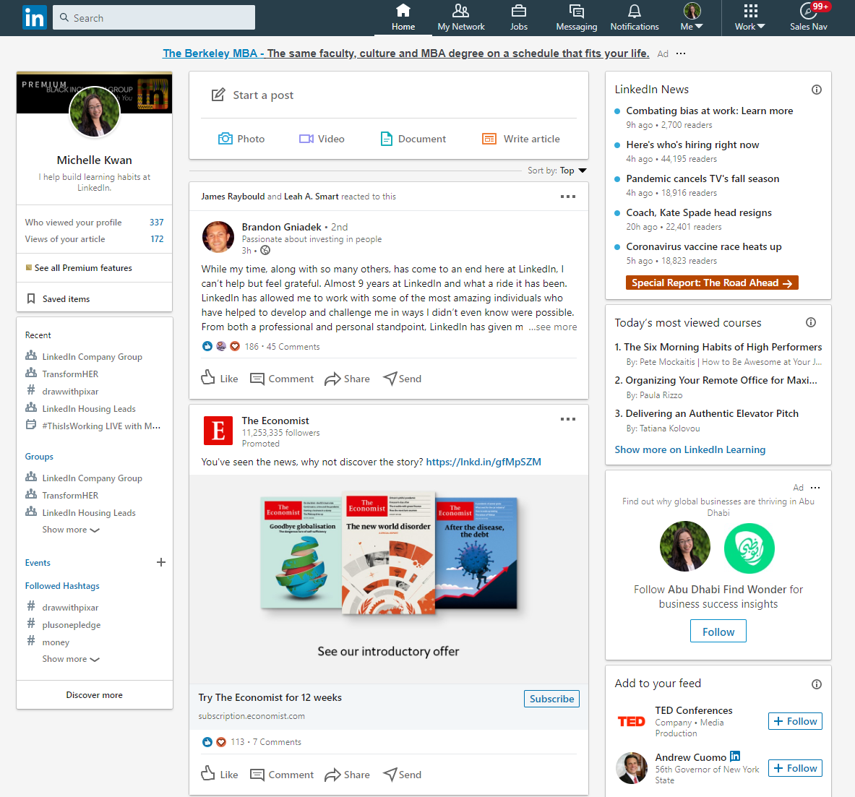
Recognizing your learners is key to driving sustained engagement
Email
LinkedIn post

Slide 8
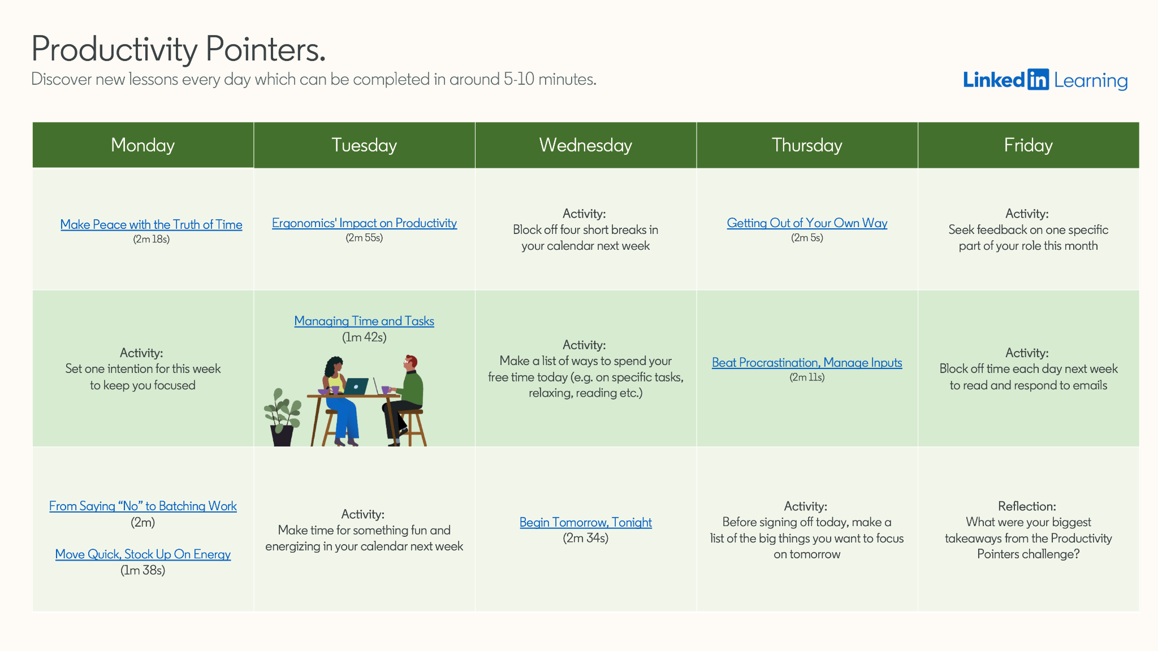
We’ve curated content to help support your Learner Recognition Campaign.
Choose from over a dozen Monthly Learner Challenges designed to help boost learner engagement. Our curated monthly challenges are packed with bite-sized content focused on helping your team learn to:
Build essential soft skills necessary to thrive in the blend of hybrid, full remote, or on-site working models
Better manage their time and tasks
Develop skill sets for career progression
Find balance between their professional and personal lives
Understand the issues that exist today and drive positive change
Example of current Featured Monthly Challenge:
Building Productive Habits can help your team learn to better manage their time and tasks, maximize their downtime, and learn to stop holding themselves back professionally.
Learn more about these challenges on the Customer Success Center or request them from your Account Team.
Notes:
Reminder to check the Customer Success Center & Content Corner for our latest mapping

Slide 9
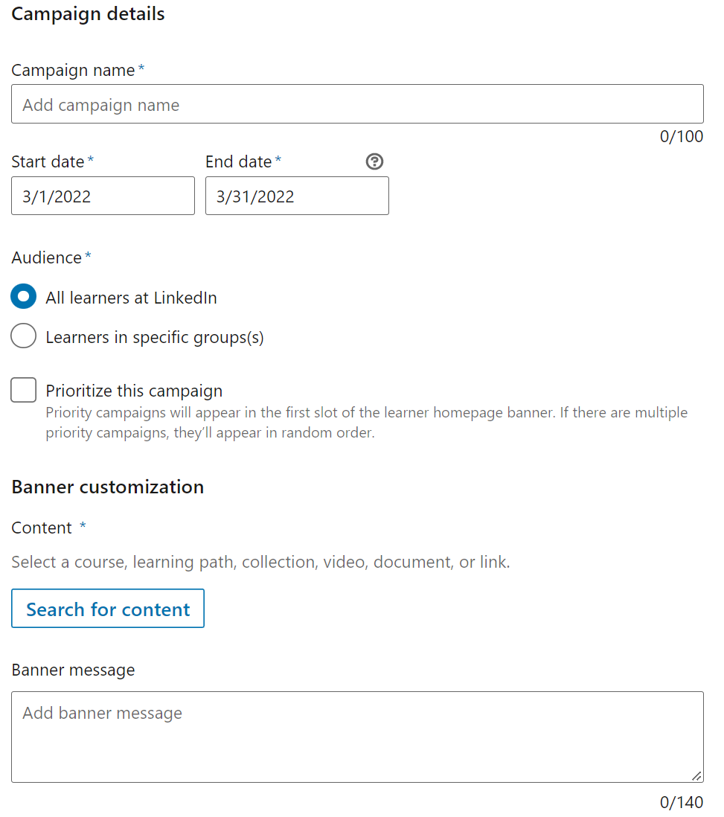
Promote your challenge by creating a campaign.
When learning challenge content is ready, follow these steps to create a campaign to promote it:
On the admin dashboard, hover over the Content tab.
In the dropdown that appears, click Campaigns.
On the Campaigns page that opens, click Create in the top right corner. Note: You can also create campaigns from the admin library page or while searching for content on the admin platform by clicking More, then Create campaign. Please note that Campaign Name won’t be displayed to learners on their homepage.
Things to consider:
You can prioritize a campaign by checking the box next to Prioritize this campaign. When a campaign is selected, it will appear to the selected group(s) of learners in the first slot.
Banner Message will appear alongside the content to learners. You can use the following wording:
Prioritize your own development by taking time to set your goals and make learning a habit!

Slide 10
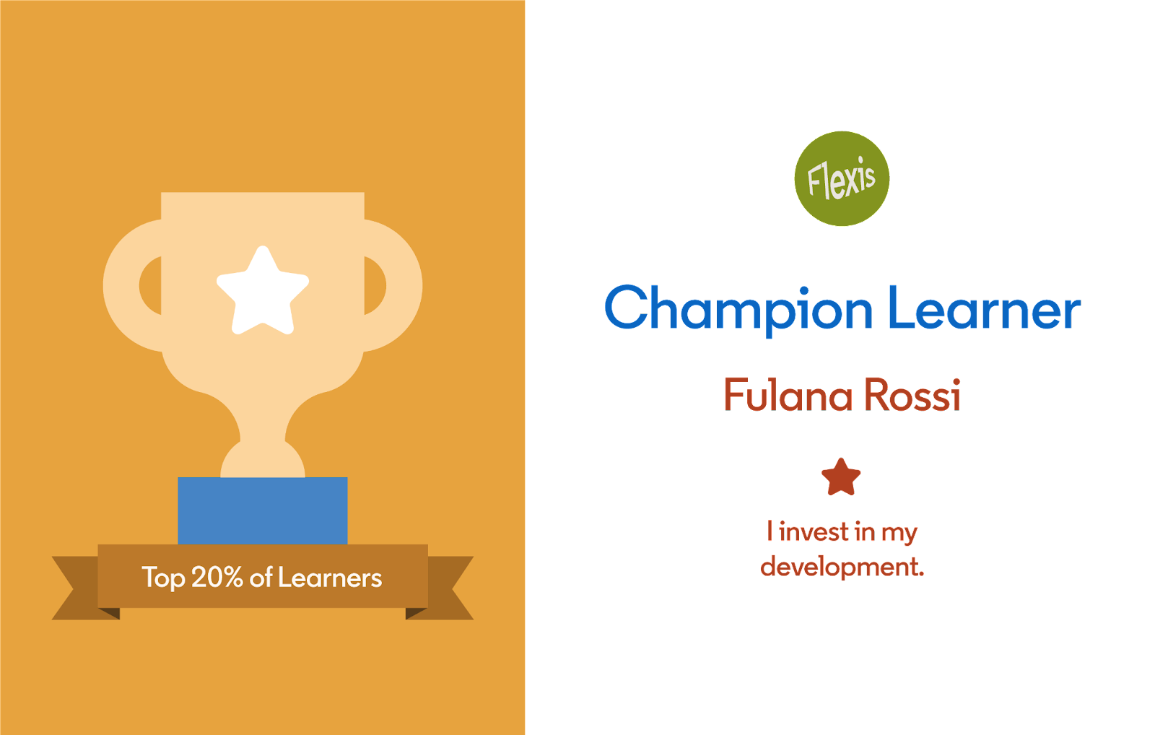
Design the learner LinkedIn profile banners
Banner Designs
Download LinkedIn profile banners
Select achievement, color, and preferred tagline
Add logo (if desired)
Remove placeholder for profile image
Export slide as image:
Under “File” select “Export”
Choose “JPEG” or “PNG” under “File Format”
Make sure Width is set to 2880 and height is set to 720
Select option to “Save Current Slide Only”

Slide 11
Design the learner badges
Badge Designs
Indicate the achievement
Add logo
Add tagline (see next slide 9)
Export slide as image (slides 13-15):
Under “File” select “Export”
Choose “JPEG” or “PNG” under “File Format”
Select option to “Save Current Slide Only”
Add to online directory
Save the share link

Slide 12
Sample Badge Taglines
Please add one of these taglines to your badge (badge templates on next page):
I invest in my development
I make learning a habit
I am committed to continuous learning
I’m growing as a professional.
I’m constantly growing.
I’m taking my skills to the next level.
I approach life as a learner.
I know there’s always more to be discovered.
I’m helping myself flourish.
I’m investing in myself and my learnings.
I’m pushing myself by committing to continuous learning.
*For customers with high seat count, we recommend building a standard badge (by leveraging templates in following slides along with a tagline) and make it available for winners to download, rather than customizing each badge with name and unique tagline

Slide 13
Super Learner

Slide 14
Champion Learner

Slide 15
Foundational Learner

Slide 16
SAMPLE – Weekly Cumulative Leaderboard Readout
Leverage this template to summarize progress, spotlight top learners, and highlight wins to your leadership team
325
124
85
# Hours Watched
Top Learners:
Stacy Jones <Stacy@xyz.com>
Kevin Smith <Kevin@xyz.com>
Jessica Morgan <Jessica@xyz.com>
# Videos Viewed
Top Learners:
Stacy Jones <Stacy@xyz.com>
Kevin Smith <Kevin@xyz.com>
Jessica Morgan <Jessica@xyz.com>
# Courses Completed
Top Learners:
Stacy Jones <Stacy@xyz.com>
Kevin Smith <Kevin@xyz.com>
Jessica Morgan <Jessica@xyz.com>

Slide 17
Deploy the
campaign
Upload
Upload your badges and LinkedIn profile banners to your shared drive and your video to LinkedIn Learning as custom content (Use the Discoverability Controls to keep it a surprise)
Add
Add share links to badges and video to your comms
Upload
Upload recipient email addresses to Sendbloom (or another email campaign tool)
Upload
Upload email template(s) and insert variable fields to reference learner (& manager) names.
Test, Test, Test
Test sending the message for quality control
Kick off
Kick off Campaign and watch for the #hashtag to appear on social media

Slide 18
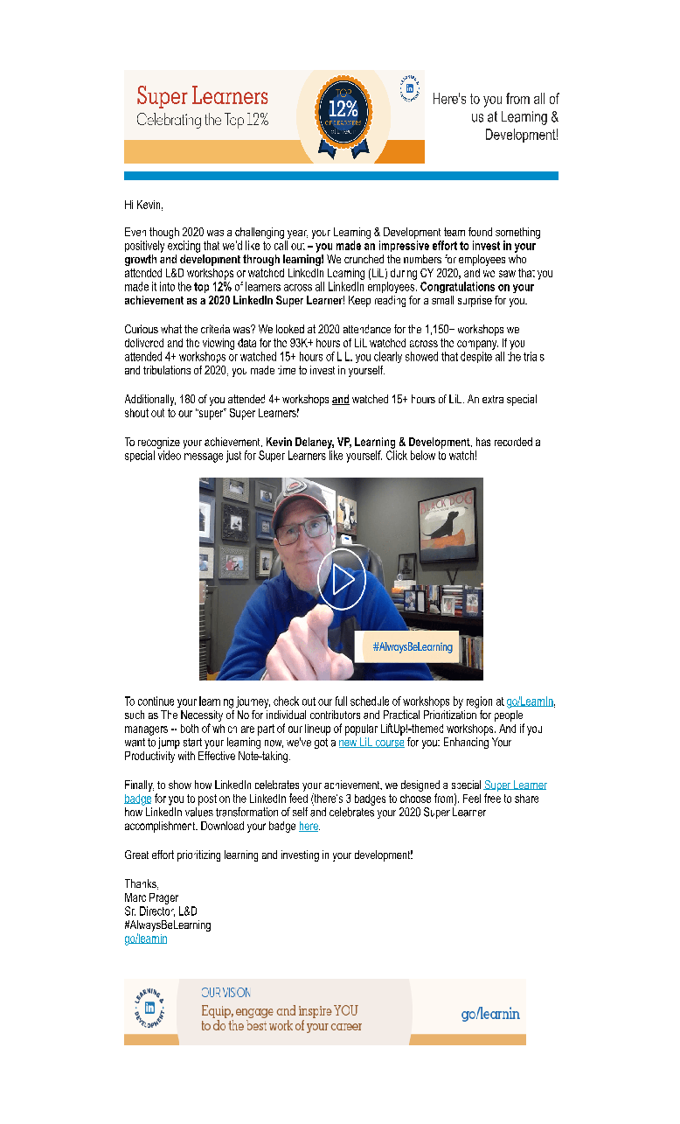
Write the copy
Compose a recognition email or use LinkedIn’s example as a template (template for download)
Suggest a #hashtag your learners should use when sharing their recognition via social media
LinkedIn Example

Slide 19
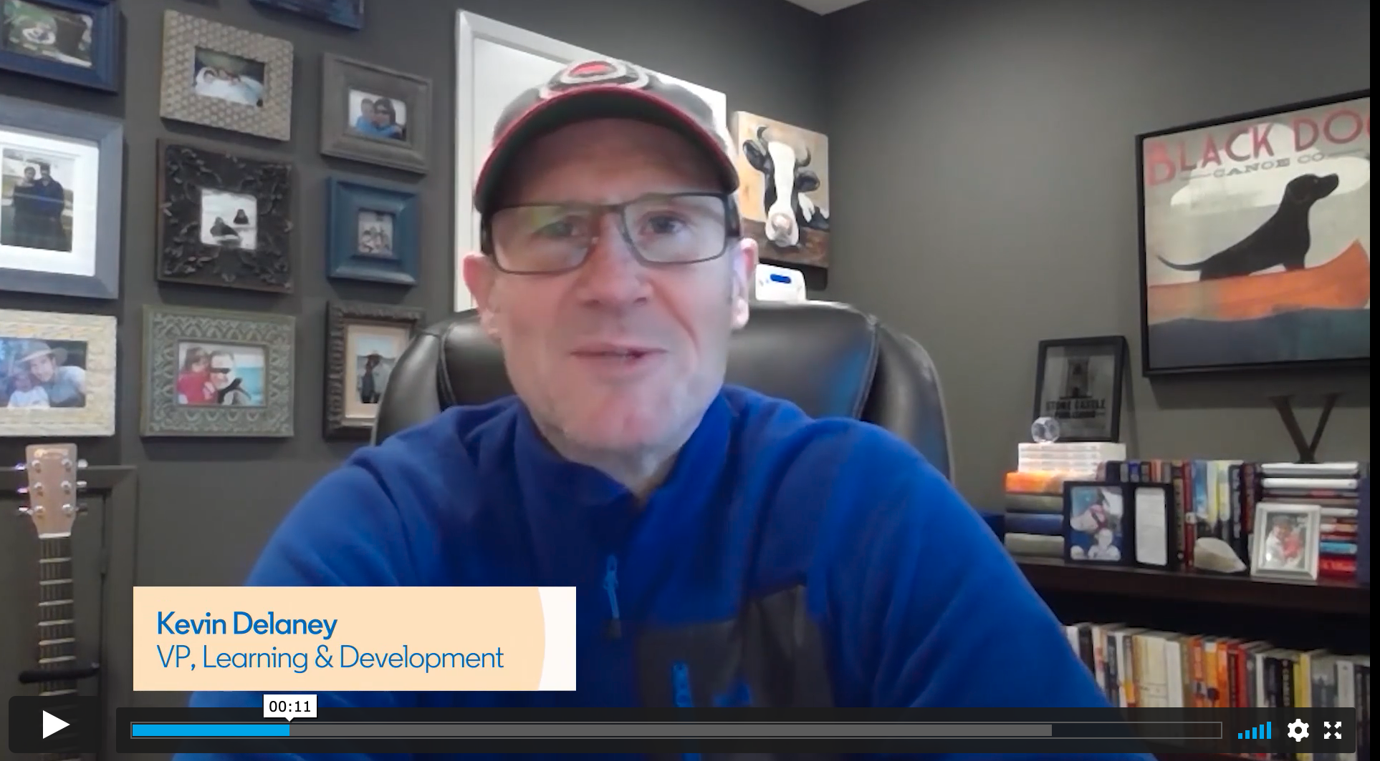
Record the video
Write a script for your leader and record the video
“Congratulations! You are a Super Learner!“
Watch Here

Slide 20
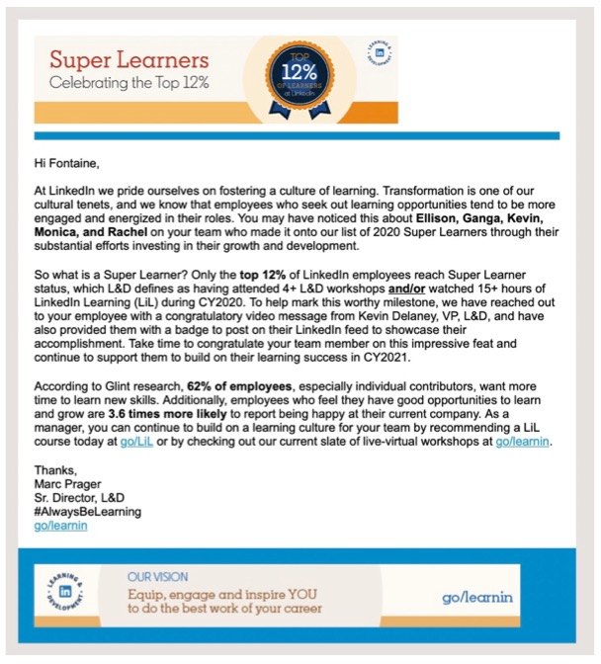
Optional: Manager Message (if data is available)
Identify the Top Learner’s Managers
Craft email copy to inform managers of their direct report’s accomplishment (template for download)
LinkedIn Example

Slide 21
Appendix

Slide 22
Identify people you need for a successful launch
Role* | Responsibilities
Global Campaign lead | Project manages launch Aligns Campaign objectives with business priorities/needs Partners with LIL CSM & L&D to define “Super Learner” achievement metrics Partners with LIL CSM and internal team to deploy campaign
Campaign sponsor (CEO, CLO, CHRO, VP/Director of L&D) | Gives buy-in on campaign objectives Records video with Super Learner Recognition
Copyrighter | Works with departmental L&D partners and LIL CSM to write copy for emails, posts & campaign sponsor script
Graphic Designer | Designs badges & email banner Uploads components to shared drive directory
LIL/LMS Full Admin | Downloads LIL Learner Summary Report Collects LMS data (if applicable) Generates Super Learner list and emails Uploads Campaign Sponsor video to LinkedIn Learning
Email Campaign Lead | Uploads emails and message template to email marketing application Tests messaging for quality control Deploys the campaign
* Individuals may play multiple roles

