Slide 1
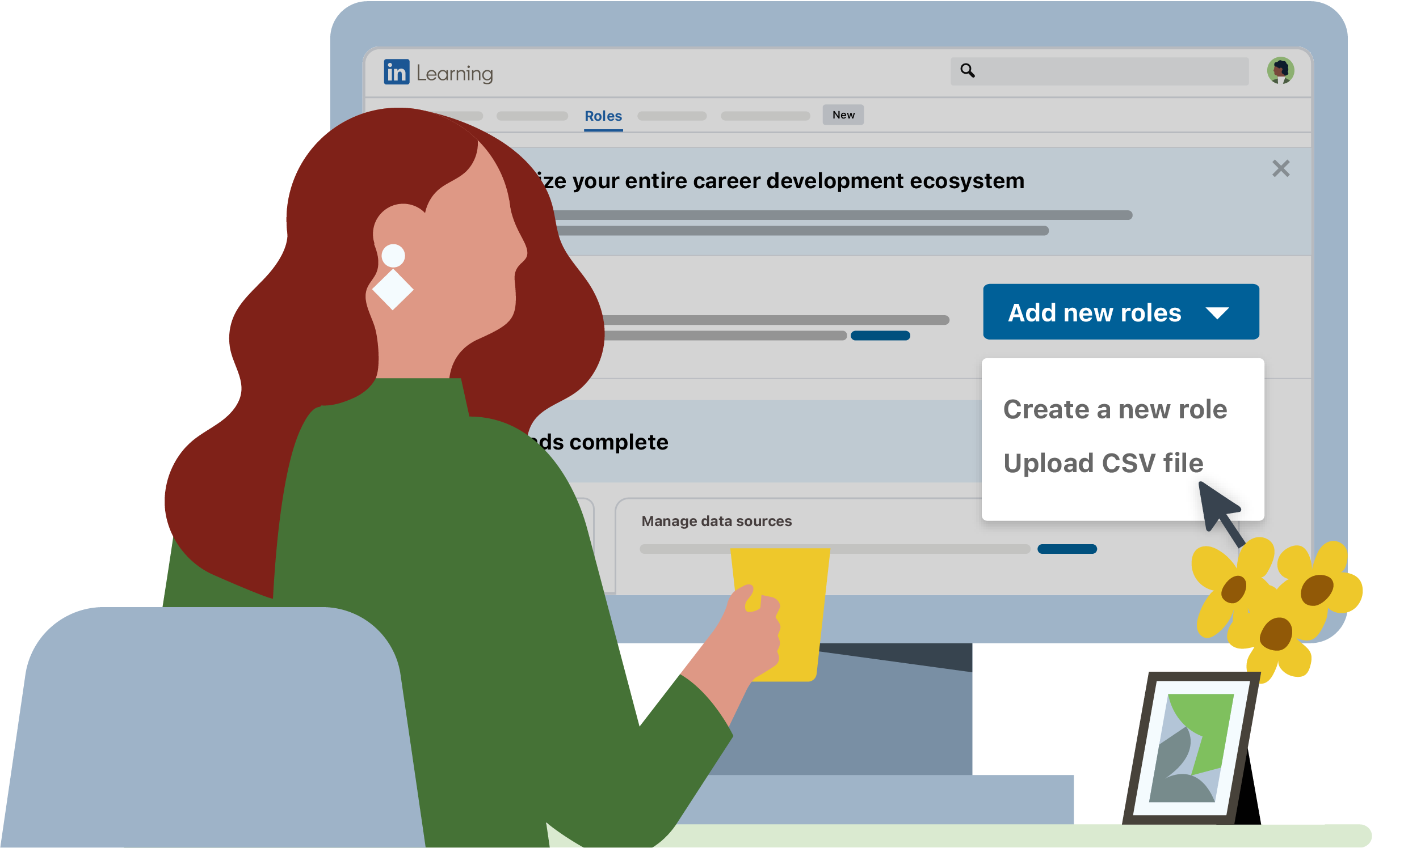






February 2025
Accelerate the creation and maintenance of your organization’s talent architecture with LinkedIn Learning’s intelligent customization tools.
Customize LinkedIn Learning to align with your talent architecture
Career Development
Where does your organization stand?
33%
have no career development initiatives or are just getting started
Aligning your talent architecture with your organization's strategy, culture, and industry standards is a manual and time-consuming effort — from detailed planning and continuous updates to comprehensive data collection and analysis.
Wherever you are in your organization's career development journey, you can efficiently create, upload, and continually update relevant skills-to-job mappings informed by LinkedIn's recommendations.
31%
have career development programs with limited adoption
36%
are leading in career development
1. Upload
2. Review LinkedIn insights
3. Publish to LinkedIn Learning
4. Download and share
5. Maintain your talent
architecture
Easily upload a CSV of your full skills-to-job mapping if you have it, or just upload a list of role titles and let LinkedIn handle the rest.
Fill in missing details like role descriptions and skills, powered by LinkedIn-recommended insights.
Publish roles to LinkedIn Learning to reflect your talent architecture across all Career Development features.
Share skills-to-job mappings with stakeholders to
ensure alignment.
Maintain your talent architecture with regular skill suggestions rooted in insights from LInkedIn's Economic Graph.
+20%
more engagement among learners in organizations using custom Role Guides.
Drive more learning with custom Role Guides

Slide 2
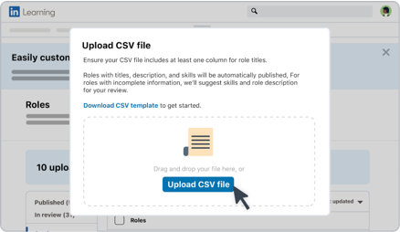
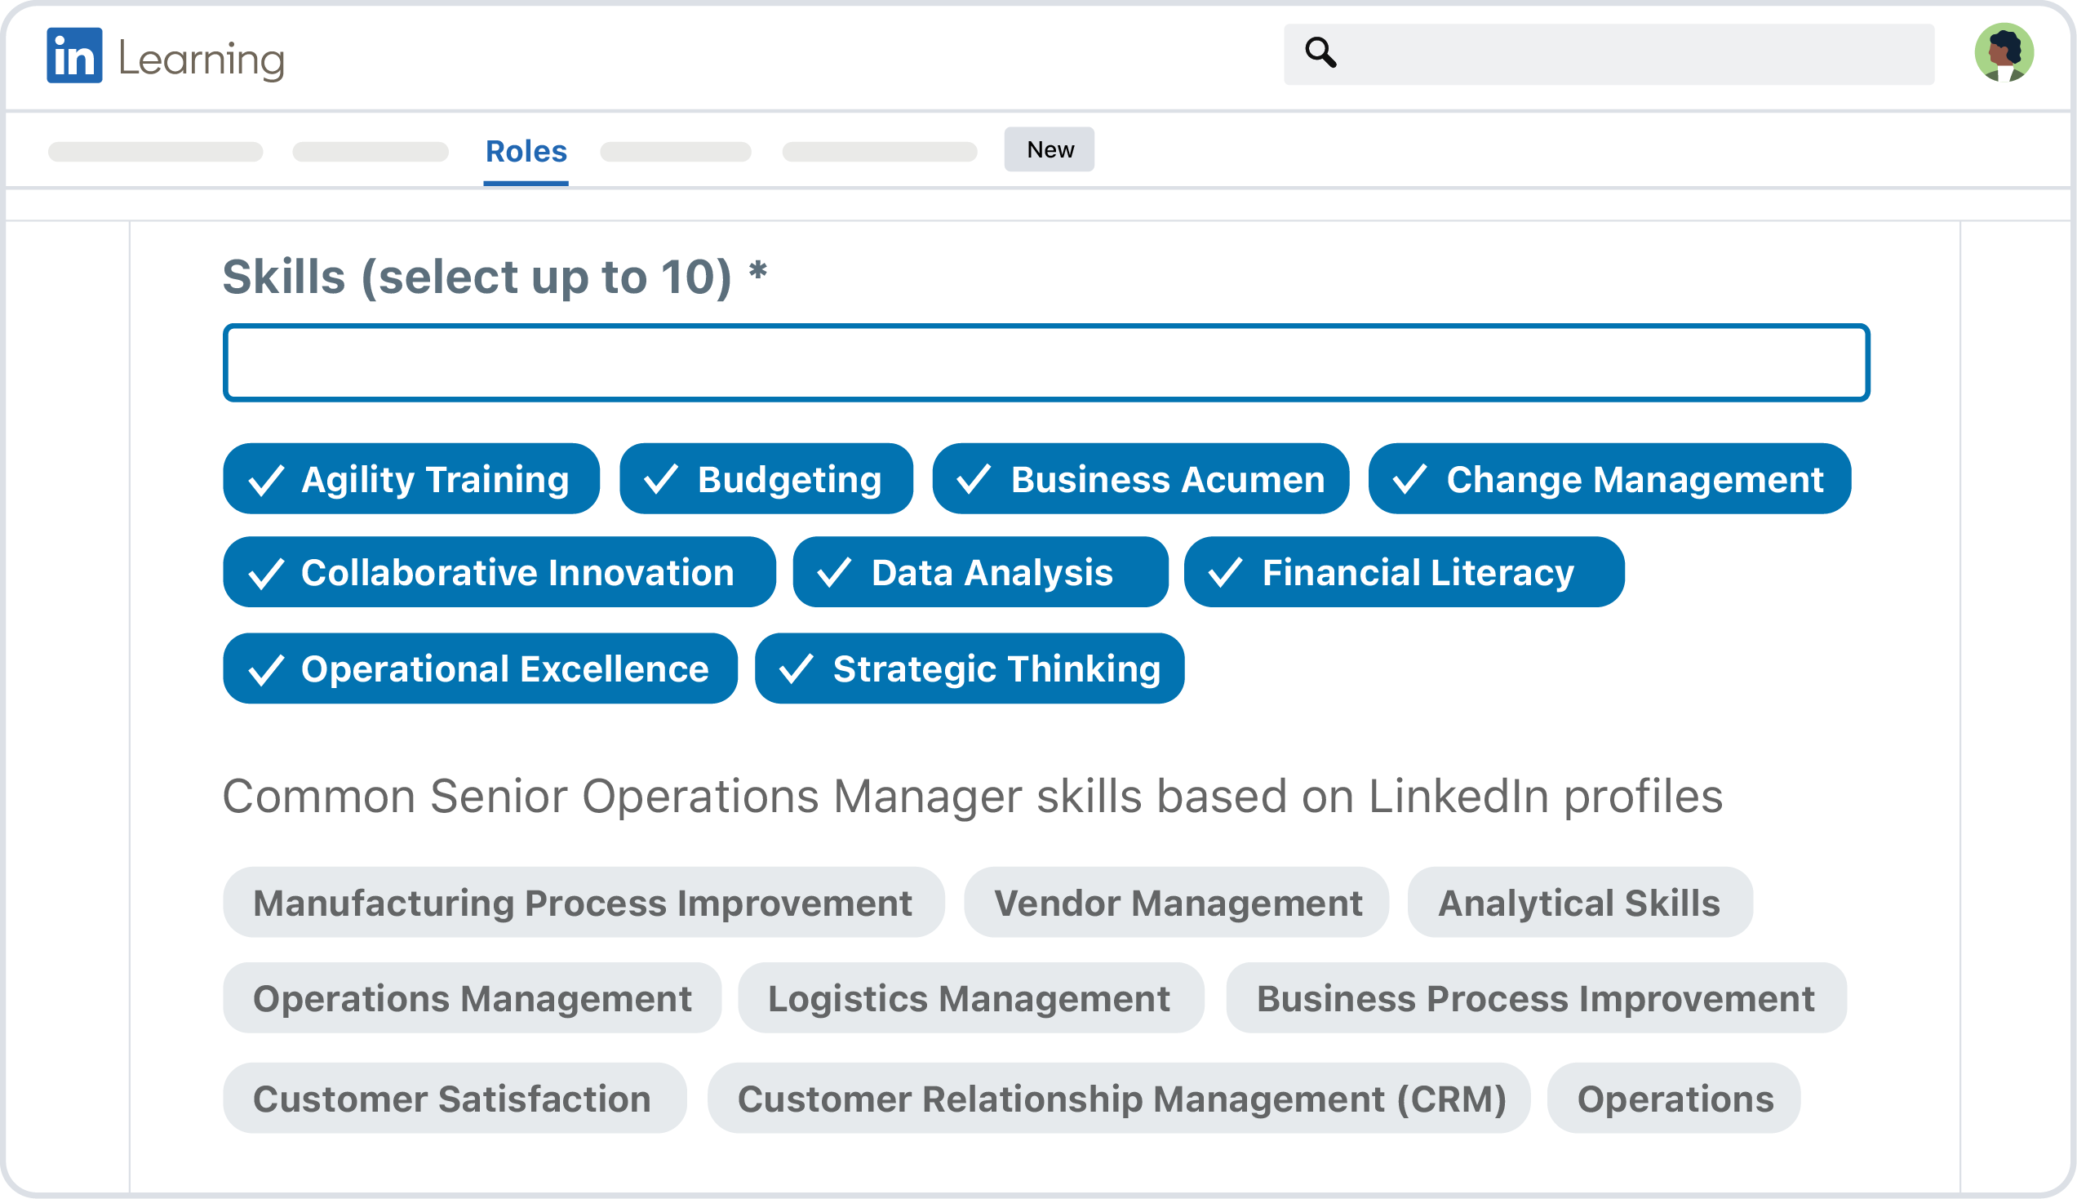
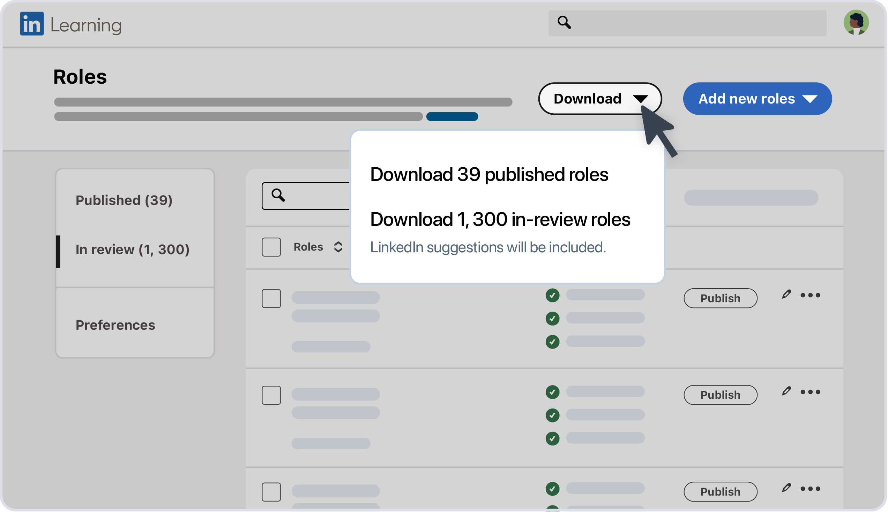


Efficiently create or update your talent architecture, wherever you are in your journey.
1
Start with a list of roles
2
Review suggestions
4
Stay relevant and up to date
Don't have a talent architecture yet?
Start by uploading a list of roles.
Close any gaps in your Role Guides with AI suggestions powered by LinkedIn data and insights.
Download your talent architecture and review it with key stakeholders and business leads to help ensure it’s current.
Already have a talent architecture?
3
Publish roles
Pro tip
Standardize and upload your skills-to-job mapping using our CSV template.
Publish roles to integrate your talent architecture across all LinkedIn Learning features, like Next Role Explorer, Role Guides, Career Goals, and Learning Plans.
Review your roles monthly to stay ahead of market trends, with LinkedIn’s ever-evolving tools, data, and insights.
Start customizing your talent architecture with LinkedIn Learning’s intelligent customization tools today.
Visit https://www.linkedin.com/learning-admin/content/roles to begin.

