Slide 1
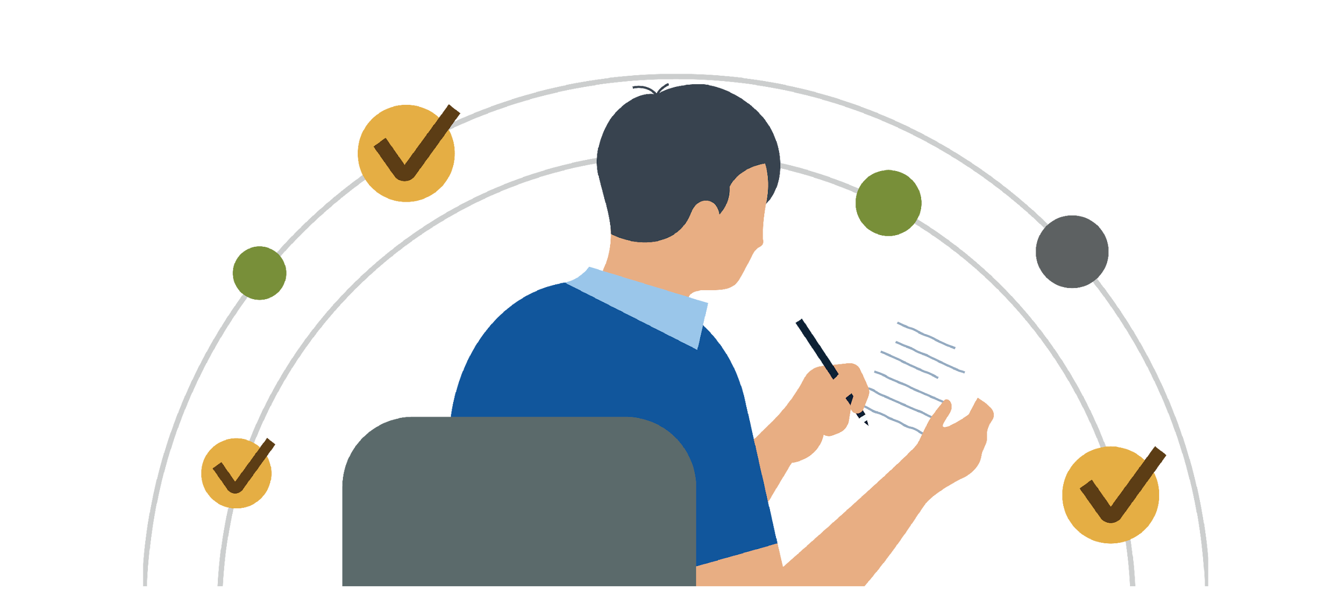
Master goal setting
Learn strategies that can help you set and prioritize goals. Don’t worry if you miss a day — you can always catch up tomorrow.
Monday | Tuesday | Wednesday | Thursday | Friday
Day 1 Identify your personal goals (3m 22s) | Day 2 Identify your why (2m 32s) | Day 3 Important goals (2m 41s) | Day 4 Making your goal manageable (2m 38s) Aligning goals with what’s most important (46s) | Day 5 Pop quiz: Why are personal goals important?
Day 6 Give yourself permission to dream (3m 42s) | Day 7 Setting your RBGs (1m 58s) | Day 8 Challenge: Set aside some time to “dream big” and write down your personal goals. | Day 9 You need all three types of goals (3m 37s) | Day 10 Sharing goals for accountability (35s)
Day 11 Pop quiz: What are the three components of healthy ambition? | Day 12 Value creation (3m 30s) | Day 13 Your biggest obstacle (2m 13s) | Day 14 Transform your obstacles (3m 33s) | Day 15 Getting ready to aim at a target and fire (2m 23s)
Day 16 Empowering yourself through language (48s) | Day 17 Charles Duhigg: Pair your ambition with a realistic plan (7m) | Day 18 Writing down your goals (40s) | Day 19 Visualization as an ally (2m 43s) | Day 20 Challenge: Choose one LinkedIn Learning course on wellbeing to explore next month.

