Slide 1
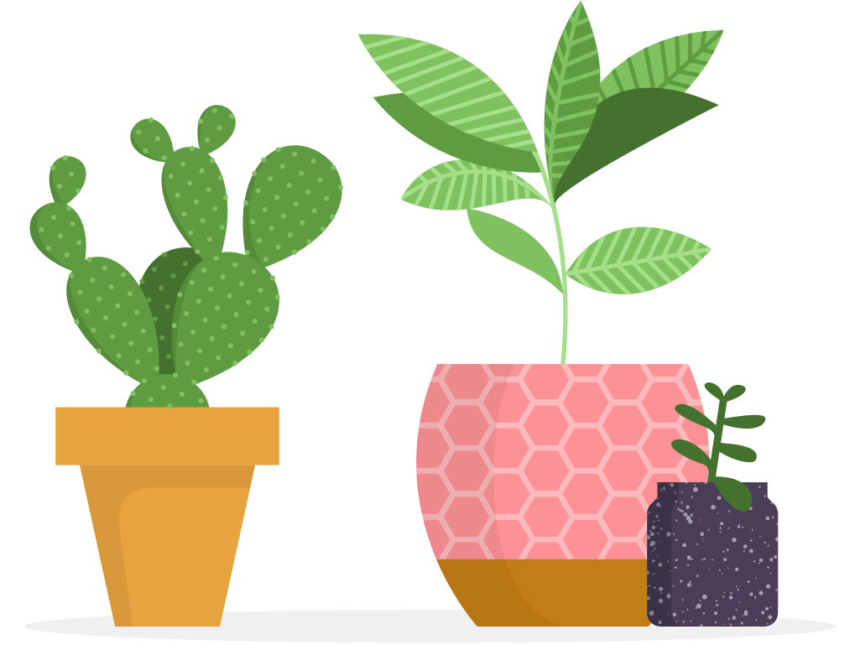
Keep Calm and Learn On
Discover new lessons every day which can be completed in around 5-10 minutes. Don’t worry if you miss a day — you can always catch up tomorrow.
Monday | Tuesday | Wednesday | Thursday | Friday
Day 1 Challenge Starts Tomorrow! | Day 2 Removing self-imposed pressure (5m 23s) | Day 3 Developing social awareness (2m 19s) | Day 4 How stress resilient are you? (4m 51s) | Day 5 Activity: Take a few minutes to think about some areas you can set boundaries for yourself
Day 6 | Day 7 Reflection: What are your favorite takeaways from the videos you explored? | Day 8 Affirm your beliefs (4m 10s) | Day 9 Engage in deliberate practice (4m 07s) | Day 10 Practice the vulnerability loop (2m 59s)
Day 11 Activity: Set one intention for this week to keep you focused. | Day 12 Dealing with stressful situations (2m 44s) | Day 13 Getting real about resilience (3m 27s) | Day 14 Challenge: Brainstorm one way you can invest in yourself this month. | Day 15 Prioritize work with purpose (1m 50s)
Day 16 Blazing new trails to confidence (3m 54s) | Day 17 Challenge: Set aside time to write down how you will implement your learning. | Day 18 Building self-awareness (3m 11s) | Day 19 Knowing who you are (3m 54s) | Day 20 Reflection: What were your biggest takeaways from the Keep Calm and Learn On challenge?

