Slide 1
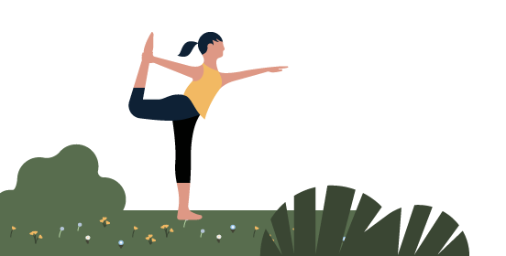
Health and Wellness
Discover new lessons every day which can be completed in around 5-10 minutes. Don’t worry if you miss a day — you can always catch up tomorrow.
Monday | Tuesday | Wednesday | Thursday | Friday
Day 1 Focus on well-being (3m 19s) | Day 2 Anchoring your workplace attitude (2m 45s) | Day 3 Using personal strengths to improve wellbeing (2m 37s) | Day 4 Activity: Aim to drink eight 8 oz glasses of water over the course of the day. | Day 5 Understand the six triggers of burnout (3m 55s)
Day 6 Build better digital habits with sleep, exercise, and mindfulness (2m 26s) | Day 7 Identifying your distinctive and instinctive strengths (2m 22s) | Day 8 Reflection: What are your favorite takeaways from the videos you explored? | Day 9 How can you find support with colleagues? (2m 55s) | Day 10 The Power of Letting Go (7m 58s)
Day 11 Activity: Set one intention for this week to keep you focused. | Day 12 Building connection for well-being (2m 34s) | Day 13 Activity: Block off two 5-minute breaks in your calendar next week for a mid-day stretch or a walk outside. | Day 14 Box breathing technique (1m 40s) | Day 15 Step 1: Map anxiety habit loops (4m 16s)
Day 16 Challenge: Set aside time to write down how you will implement your learning. | Day 17 What do you need to protect your well-being? (2m 51s) | Day 18 Challenge: Brainstorm one way you can invest in yourself this month. | Day 19 Strategy 8: Using self-care as an optimism-boosting strategy (3m 34s) | Day 20 Reflection: What were your biggest takeaways from the Health & Wellness challenge?

