Slide 1
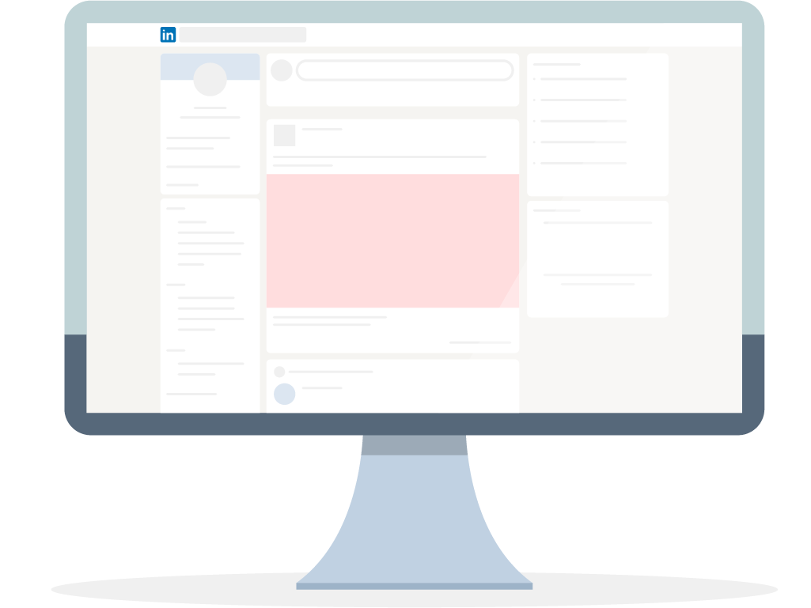
Increase Your Cybersecurity Awareness
Explore new cybersecurity videos every day that can be completed in around 5–10 minutes. Don’t worry if you miss a day — you can always catch up tomorrow.
Monday | Tuesday | Wednesday | Thursday | Friday
Day 1 Discover cybersecurity awareness (1m 50s) | Day 2 Laptop and desktop security (7m) | Day 3 Protect against malware and ransomware (2m 27s) | Day 4 Updating software (6m 7s) Why updates are so important (3m 36s) | Day 5 Activity: Install the latest security updates for all your devices and turn on automatic updates for your operating system.
Day 6 Password attacks (6m 23s) | Day 7 Password security (8m 22s) Challenge: Password strength tests (1m 42s) | Day 8 Activity: Change all your passwords that are three months old or older, and set a calendar reminder to do this every three months. | Day 9 Multi-factor authentication (8m 25s) | Day 10 Configure multifactor authentication (12m 25s)
Day 11 Activity: Enable multi-factor authentication for every app that gives you the option. | Day 12 Understanding the top five attacks in the cloud (4m 42s) | Day 13 Defeat social engineers and cyber scammers (1m 35s) | Day 14 Email phishing (1m 55s) | Day 15 Catch a phish red-handed: Common indicators of a phish (5m 20s)
Day 16 A bridge between business and tech (1m 31s) | Day 17 The BizOps and cybersecurity disconnect (2m 21s) | Day 18 Incident management to respond to a cyber attack (4m 17s) | Day 19 Email phishing (5m 45s) | Day 20 Activity: Bookmark federal agency sites (FTC, IRS, FBI) for the latest cybersecurity news and alerts.

