Slide 1
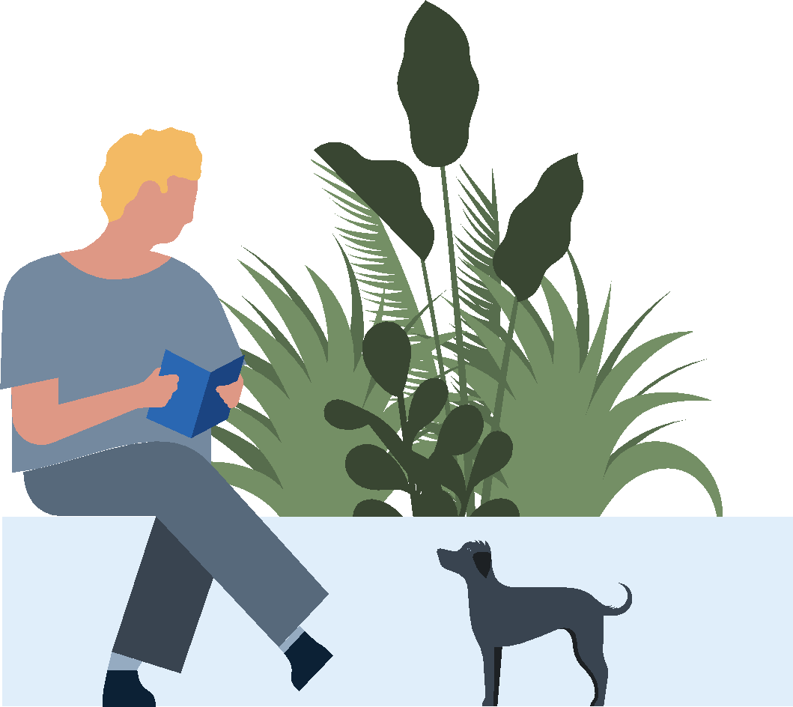
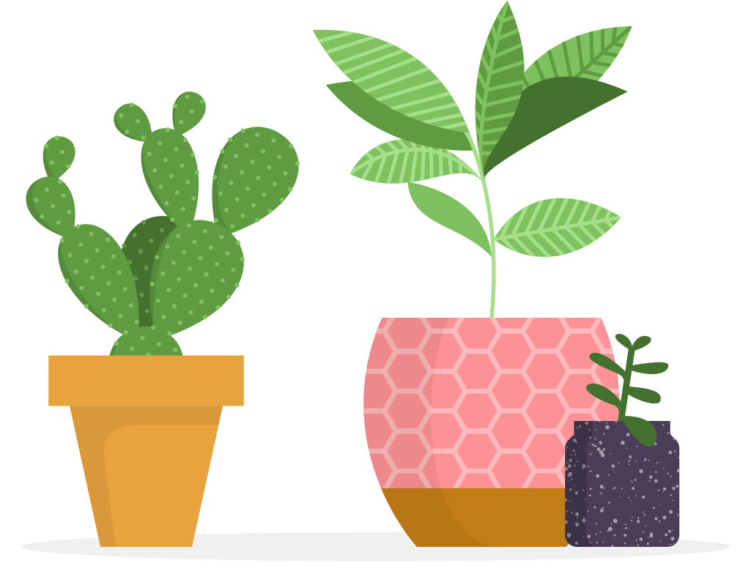
Cultivating Joy
Discover new lessons every day which can be completed in around 5-10 minutes. Don’t worry if you miss a day — you can always catch up tomorrow.
Monday | Tuesday | Wednesday | Thursday | Friday
Day 1 Harnessing Awe to Boost Wellbeing (2m 59s) | Day 2 Relationships Keep You Happier and Healthier Across Your Lifespan (1m 20s) | Day 3 Envisioning You as Your Best to Build Optimism (3m 17s) | Day 4 Recognizing Passions (2m 54s) | Day 5 Discover Your "Why" (3m 40s)
Day 6 Activity: List three moments of joy from the past week | Day 7 Finding Joy With Dopamine (3m 33s) | Day 8 Activity: Take three minutes to tidy and declutter your workspace. How do you feel once you’ve done this? | Day 9 Practice Empathy and Compassion (2m 47s) | Day 10 Just Say No! (3m 11s)
Day 11 | Day 12 De-stress-to Let Happiness In (4m 01s) | Day 13 Challenge: Brainstorm one way you can invest in yourself this month. | Day 14 Help Others Win (4m 58s) | Day 15 Activity: Block off 5 minutes next week to send a note of gratitude or well wishes to a colleague
Day 16 Reflection: What are your favorite takeaways from the videos you explored? | Day 17 Balancing Personal Time for Yourself and Others (1m 58s) | Day 18 Discovering Genuine Gratitude (3m 57s) | Day 19 Activity: List three moments of joy from the past week | Day 20 Reflection: What were your biggest takeaways from the Cultivating Joy challenge?

