Slide 1
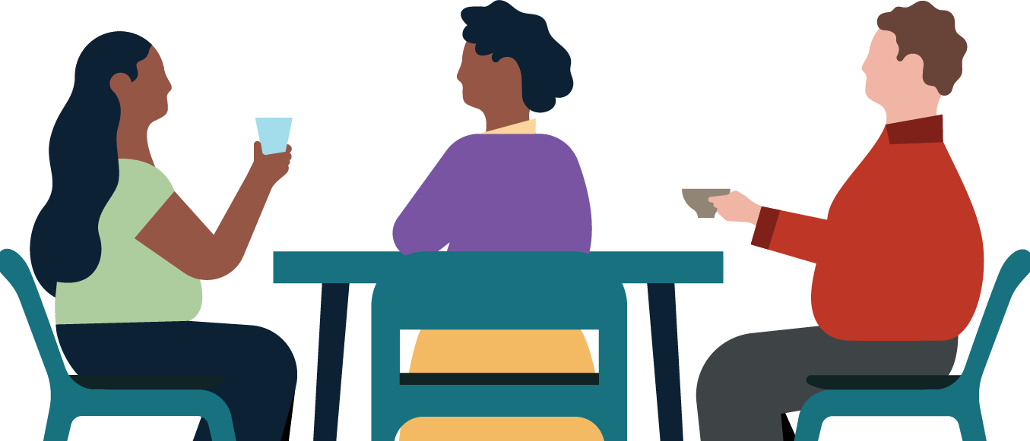
Create a work-life balance that works for you.
Learn how to maintain a healthy work-life balance with these essential strategies for staying focused, motivated, and fulfilled. Don’t worry if you miss a day — you can always catch up tomorrow.
Monday | Tuesday | Wednesday | Thursday | Friday
Day 1 Taking control of your wellbeing (4m 02s) | Day 2 Nourish your personal life (2m 58s) | Day 3 Focus on what feeds your spark (2m 48s) | Day 4 Gratitude and service (3m 07s) Give yourself medals daily (2m 20s) | Day 5 Question: How would you describe your own wellbeing?
Day 6 A connected tribe: Connection (4m 54s) Creating a helpful self-image (5m 31s) | Day 7 Building self and emotional awareness (4m 30s) | Day 8 Challenge: Choose one thing to do this weekend that’ll create more balance in your life. | Day 9 Disconnect from work after hours (2m 54s) | Day 10 Build better digital habits with sleep, exercise, and mindfulness (2m 6s)
Day 11 Pop quiz: What can you do to create a more peaceful sleep environment? | Day 12 Current state of affairs (2m 35s) | Day 13 What is psychological safety? (2m 34s) | Day 14 Communicating in high stress situations (0m 46s) | Day 15 The stress mastery formula (2m 24s)
Day 16 Choose happiness (3m 52s) | Day 17 Pop quiz: How can you use stress for good? | Day 18 Who you are anywhere is who you are everywhere (2m 29s) | Day 19 Move through stress your way (2m 57s) | Day 20 Challenge: Choose one LinkedIn Learning course on wellbeing to explore next month.

