Slide 1
Train The Trainer
Welcome to
for Jobseekers
Notes:
DO: Invite the audience to ask questions.​
Answer questions before starting the jobseeker “Mock class”

Slide 2
What we will cover in this workshop
Introduction - What is LinkedIn?
STEP
03
Build Your LinkedIn Network
STEP
01
Create A LinkedIn Account
STEP 04
Search And Apply For Jobs On LinkedIn
STEP
02
Build A LinkedIn Profile That Attracts Employers
EC
Extra Credit
Notes:
SAY: In today’s workshop you will learn…​
How to connect to jobs with LinkedIn.​

Slide 3
What do you do on social media?
I like donuts
Watch me eat a donut
Here’s a cool photo of my donut
Here’s a donut recipe
I’m listening to “Donuts”
Anyone want a donut?
Notes:
GOAL: To highlight how LinkedIn is different from other social networks.​
​ SAY: You do different things on different social media channels. From taking selfies to looking up recipes. But where does LinkedIn fit in?

Slide 4
On LinkedIn:
I hope to operate a donut franchise one day
I’m looking for a job at a donut company
I have three years experience making donuts
My top skills are donut production and sales
Here are 3 recommendations from former donut colleagues
Notes:
GOAL: Explain how professionals use LinkedIn.​
​ SAY: LinkedIn is the social network for professionals.

Slide 5
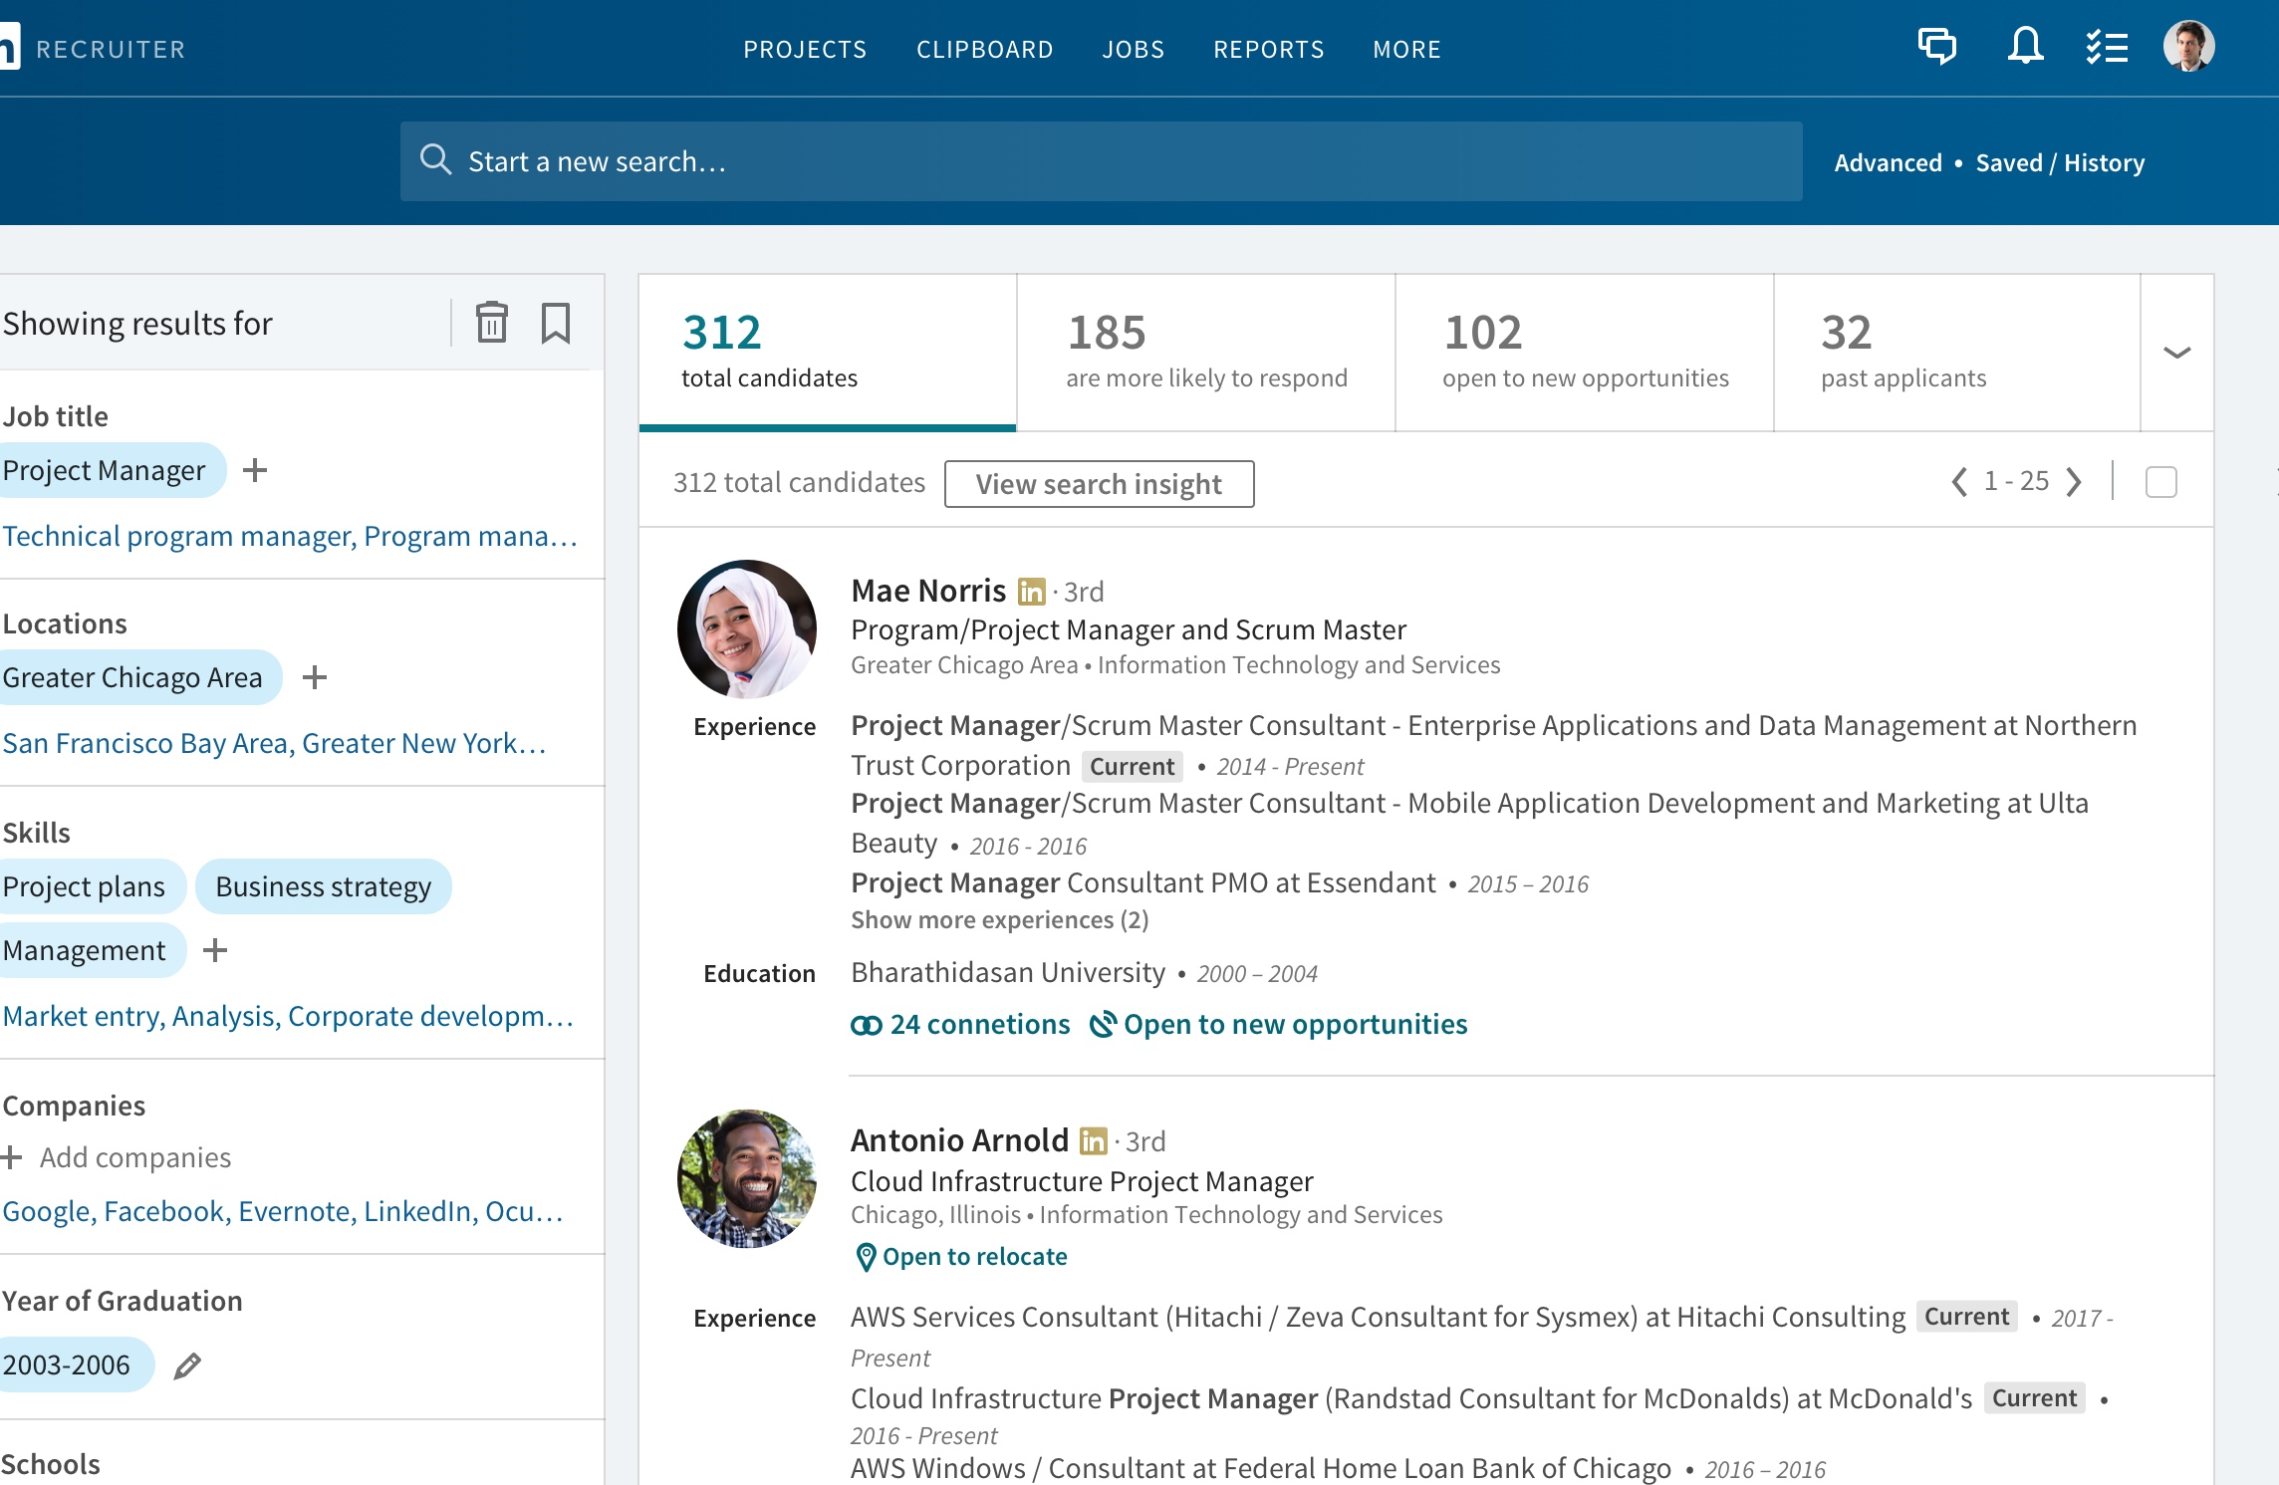
Employer’s Journey on LinkedIn
95% of Fortune 500 companies use LinkedIn for recruiting and sourcing talent.
Over 300,000 companies, including small businesses, find talent on LinkedIn.
1.4 million recruiters are actively using LinkedIn to find and engage talent.
70% of people were hired at a company where they had a connection.
85% of employers say a positive online reputation influences their hiring decision
Notes:
GOAL: Show trainers that hiring managers or recruiters will most likely go to LinkedIn and view profiles before deciding if they want to interview the candidate.. ​
​
SAY: Before we start the mock class, I want to show you how Recruiters use LinkedIn and why we want jobseekers to complete all of the steps on the checklist. ​
In one of our examples, you’ll see that LinkedIn influences how employers find and screen candidates. We’ll touch on that again in a bit.​
​
DO: A demo of LinkedIn Recruiter Spotlight search.​

Slide 6
Connect to Jobs
20.5 million people on LinkedIn are open to new job opportunities
More than 30 million employers with over 20 million available jobs on any given day
100 million job applications submitted every month
Notes:
GOAL: To show who is on LinkedIn and the hiring activities on LinkedIn. ​
For jobseekers to understand that if they didn’t use LinkedIn to apply for a job, the hiring manager or recruiter will most likely still go to LinkedIn and view their profile before deciding to interview them.​
​
SAY: 2.5 million people on LinkedIn are hired through their connections every year​
Don’t just apply to jobs, connect to jobs on LinkedIn​
Regardless of how the hiring manager first learns about you, most likely they are checking out your LinkedIn profile before deciding to bring you in for an interview.

Slide 7
“Finding a job at my age (55+) seemed impossible. I turned to LinkedIn… 80% of my interviews were generated through LinkedIn, 60% did not involve a recruiter.”
LinkedIn member
Littleton, Co

Slide 8
“LinkedIn is an irreplaceable tool in my career. The ability to show employers the exact experience and skill sets you have on your profile… ultimately helped me get the job!”
LinkedIn Member
Boston, MA

Slide 9
STEP 01
Set Up Your Account
Create a LinkedIn Account
Import Your Contacts
Add a Photo
Download the LinkedIn Mobile App
DID YOU KNOW? 9 out of 10 employers use LinkedIn during the hiring process.

Slide 10
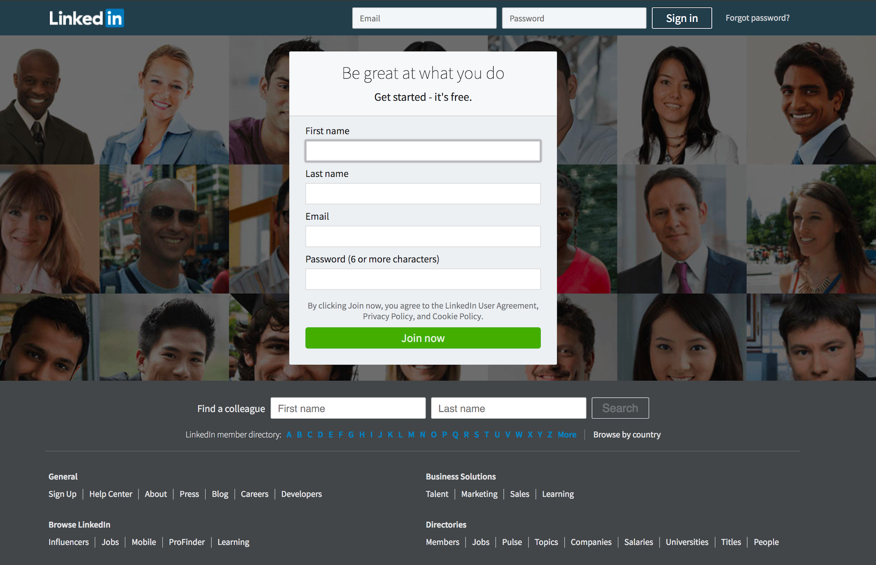
STEP 01
Set Up Your Account
Go to LinkedIn.com and complete the prompts, including:
Location
Industry
Reason for Joining
Notes:
SAY: To start connecting with your professional world, we will first need to create a LinkedIn account. Go to linkedin.com and complete the prompts that follow.​
​ !NOTE: If participants forget their LinkedIn sign-in information, they can complete a verification process on the LinkedIn website. However, doing so could become time-consuming and distract from the workshop’s learning goals. Advise participants to proceed carefully and methodically when completing their profile, to follow on-screen instructions, and to be attentive about remembering their account login information. ​

Slide 11
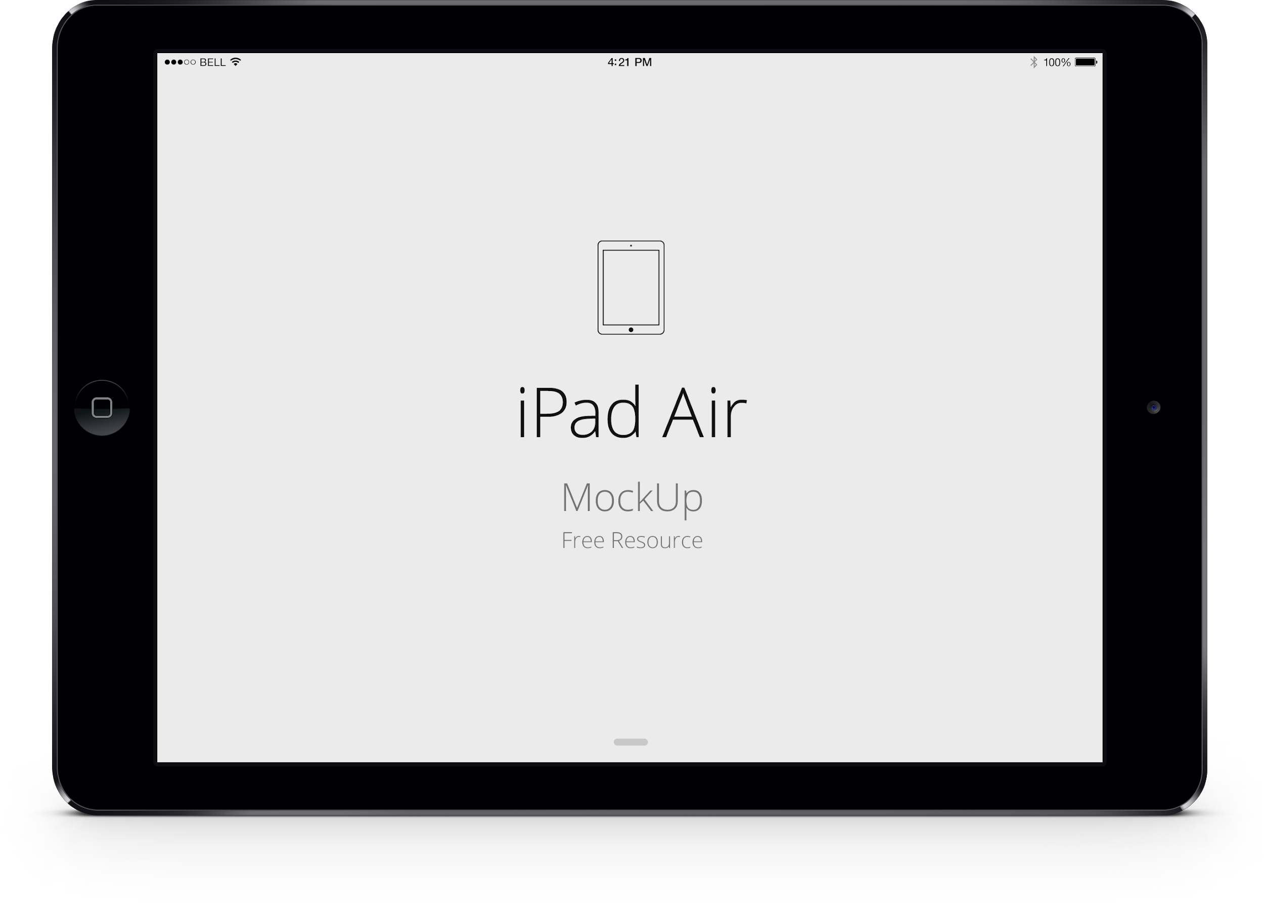
Import Your Contacts
STEP 01
Inviting and Importing Your Email Contacts
Sync your email account to connect with people you already know on LinkedIn.
Notes:
DO: Click middle of the screenshot to play the video
SAY: Add your email address in the next screen to import your contacts and begin connecting with people you know.

Slide 12
Add a Photo
STEP 01
Introducing LinkedIn Photo Editing
Members with profile photos receive up to 21x more profile views and 9x more connection requests.
Download the LinkedIn Mobile App to take, upload, and edit a new profile photo.
Notes:
GOAL: Get jobseekers to upload a profile photo.
DO:Click middle of the screenshot to play the video
SAY: Profiles with photos get up to 21 times more views.
This helps humanize your profile and makes you more approachable.
If you don’t have profile-worthy photo handy, click “skip” for now to move on to the next step and download the LinkedIn Mobile App.
In the app, you can easily use your phone to take, upload, and edit a photo.

Slide 13
STEP 02
Profile Vs Resume
Build a LinkedIn Profile That Attracts Employers
Take a Great Photo
Edit Your Profile
Privacy Settings
DID YOU KNOW? Over 50% of hiring managers use LinkedIn profiles to qualify jobseekers
Notes:
GOAL: To teach the jobseekers how to build a profile that is optimized for skill-based hiring.​
​ SAY: More than half of hiring managers will decide whether to move forward with your application based on your LinkedIn profile. A detailed LinkedIn profile will help you get your foot into more doors.​

Slide 14
STEP 02
Profile vs Resume
There are big differences between your LinkedIn profile and your resume.
For example, your LinkedIn profile:
Speaks to all potential employers, not just a single one
Goes into more detail with skills, projects, interests, certifications, and more
Contains recommendations and endorsements
Allows other professionals and employers to interact, learn, and contact you
Notes:
SAY: Your LinkedIn profile is different from a resume. ​

Slide 15
STEP 02
Take a Great Photo
Before taking your photo, make sure you:
Use a background that isn’t distracting
Dress for the job you want
Smile and have a friendly expression
To create a good profile picture, double check that your face takes up a majority of the frame.
Notes:
GOAL: Show jobseekers how to take a great headshot for their profile.​
​ SAY: Having an inviting, well-lit photo for your profile will leave recruiters and employers with a good impression.​

Slide 16
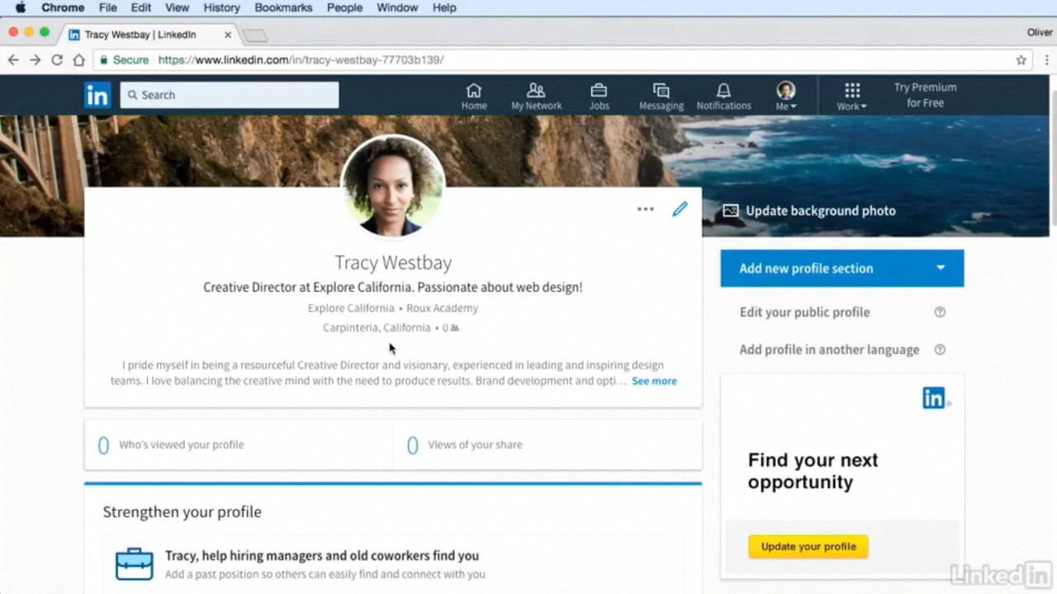
STEP 02
Edit Your Profile: Your story in your words
Click the “Me” icon at the top of your LinkedIn homepage.
On the right side of the page, click “Add new profile section” to begin editing and adding to your profile.
Add your:
Headline
Location & Industry
Summary
Work Experience
Volunteer Experience
Education & Certifications
Skills
Notes:
GOAL: For jobseekers to add sections to and complete their LinkedIn profiles. ​
​ SAY: Members with complete and accurate profiles are discovered by more employers and recruiters. Click on the “Me” icon at the top of your homepage to begin editing your profile. Make sure to add all of your work and volunteer experience, skills, education, location, and more if you haven’t already.​
​
DO: Click on the screenshot on the left of the slide to play the video.​
​ ​

Slide 17
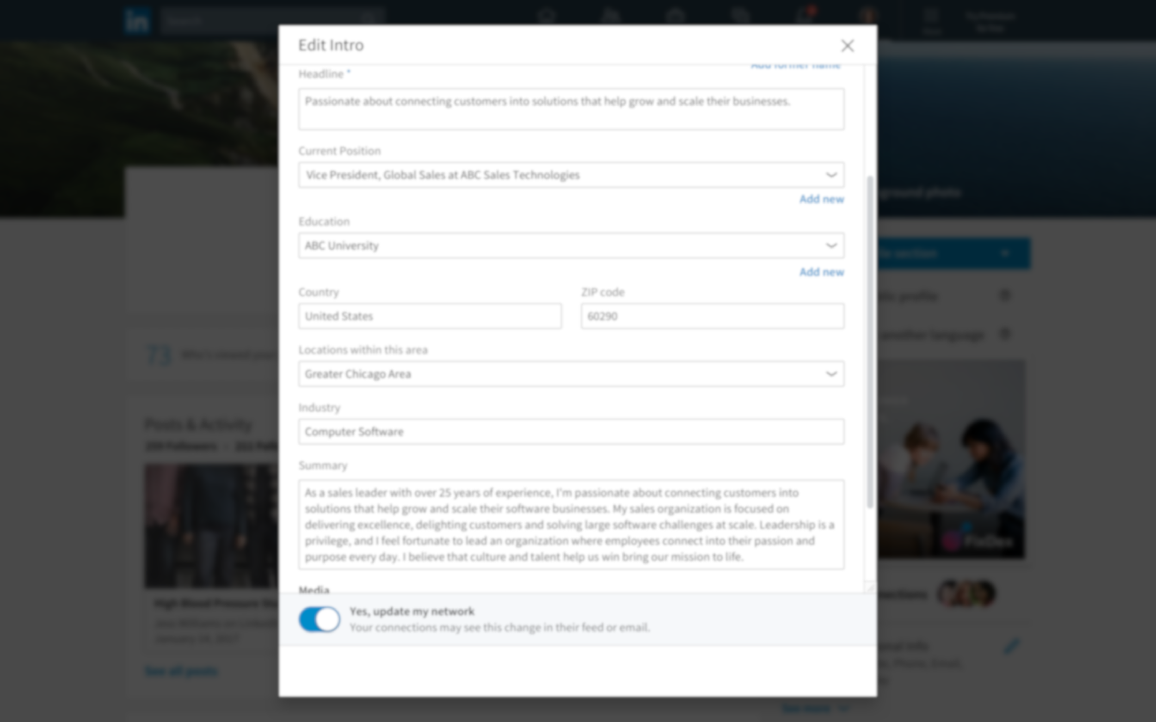
STEP 02
Write a Compelling Headline
5 - 10 words that make it clear what you do or what you want to achieve
May include your current position.
Leave us wanting more.
For job seekers, it may be appropriate to write they are actively seeking employment.
Notes:
​ YOU CAN SAY​
Adding your industry is really important. Often it’s how others will find you and add you to their professional network.​
In addition, adding your industry will give you up to 9X more profile views!​
Members with industry information are discovered up to 38X more in recruiter searches​
It’s simple, click the pencil at the top of your profile where your headshot and name are and scroll down to edit or add your industry.​
​

Slide 18
STEP 02
Add Your Industry
Members with industry information receive up to 9x more Profile views.
More than 300K people search by industry on LinkedIn every week.
Notes:
​ YOU CAN SAY​
Adding your industry is really important. Often it’s how others will find you and add you to their professional network.​
In addition, adding your industry will give you up to 9X more profile views!​
Members with industry information are discovered up to 38X more in recruiter searches​
It’s simple, click the pencil at the top of your profile where your headshot and name are and scroll down to edit or add your industry.​

Slide 19
STEP 02
Draft A Summary
Your “elevator pitch”
Focus on career accomplishments and aspirations
40+ words
Notes:
​ YOU CAN SAY​
Adding your industry is really important. Often it’s how others will find you and add you to their professional network.​
In addition, adding your industry will give you up to 9X more profile views!​
Members with industry information are discovered up to 38X more in recruiter searches​
It’s simple, click the pencil at the top of your profile where your headshot and name are and scroll down to edit or add your industry.​

Slide 20
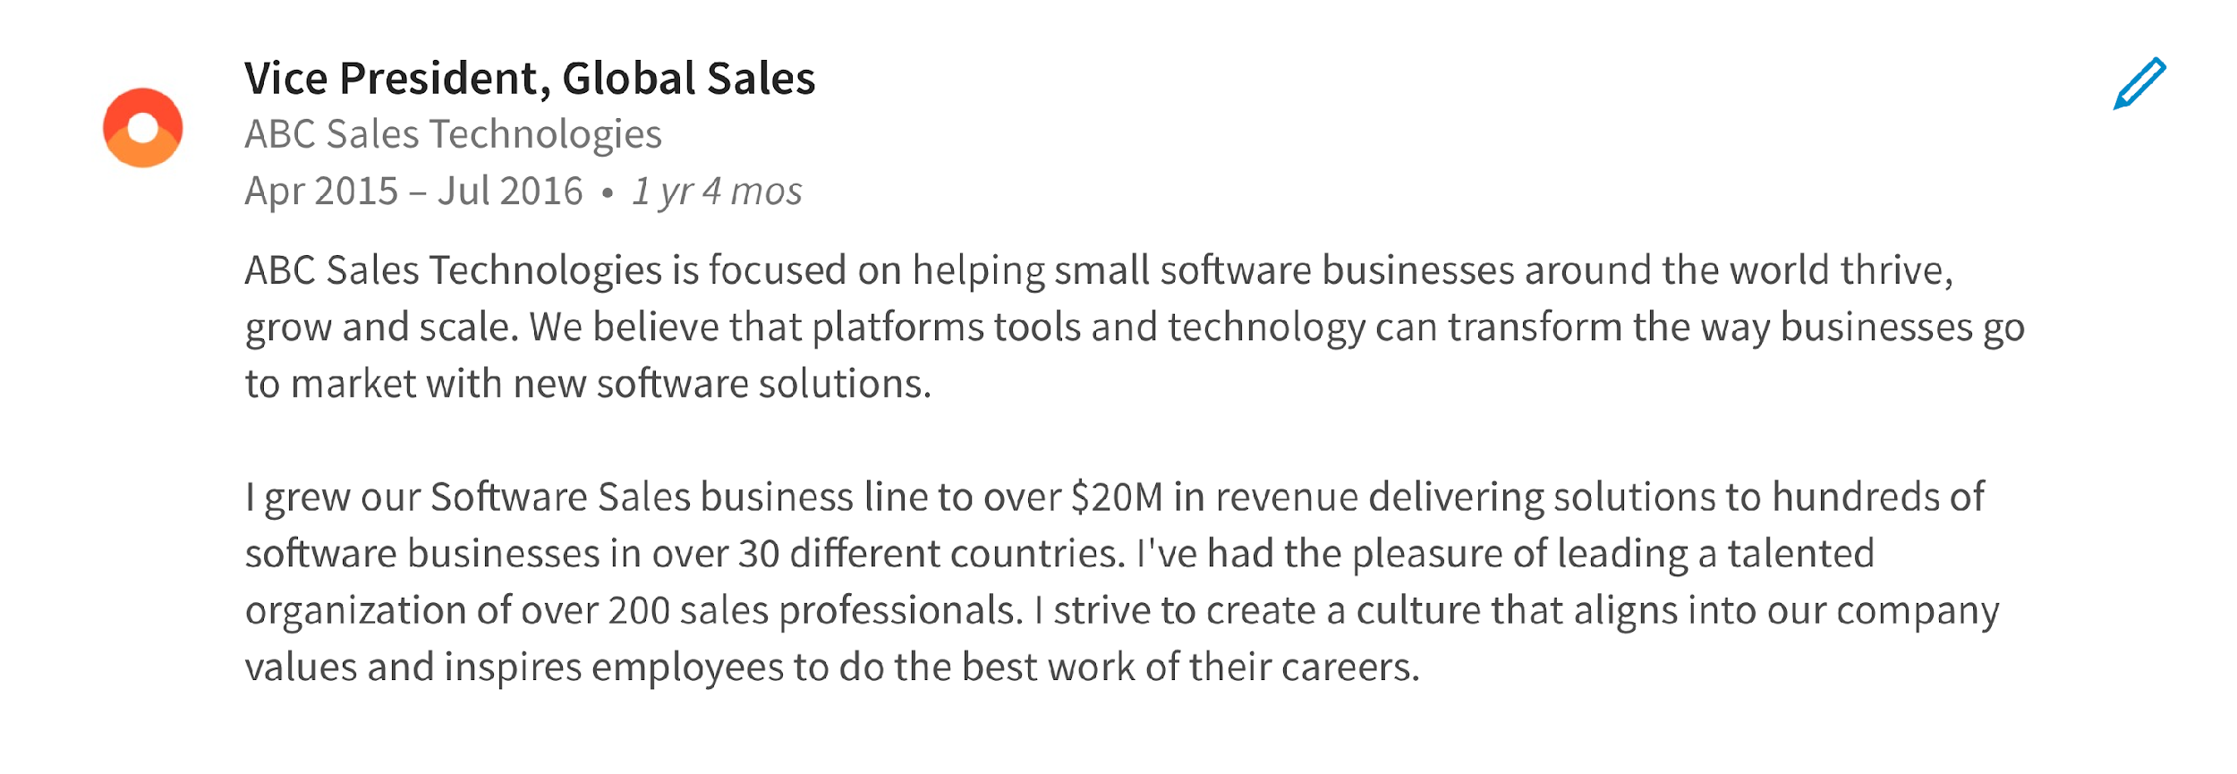
STEP 02
Detail Your Work Experience
Member with up-to-date positions receive up to:
5x more connection requests
8x more Profile views
10x more messages
Notes:
​ YOU CAN SAY​
Adding your industry is really important. Often it’s how others will find you and add you to their professional network.​
In addition, adding your industry will give you up to 9X more profile views!​
Members with industry information are discovered up to 38X more in recruiter searches​
It’s simple, click the pencil at the top of your profile where your headshot and name are and scroll down to edit or add your industry.​

Slide 21
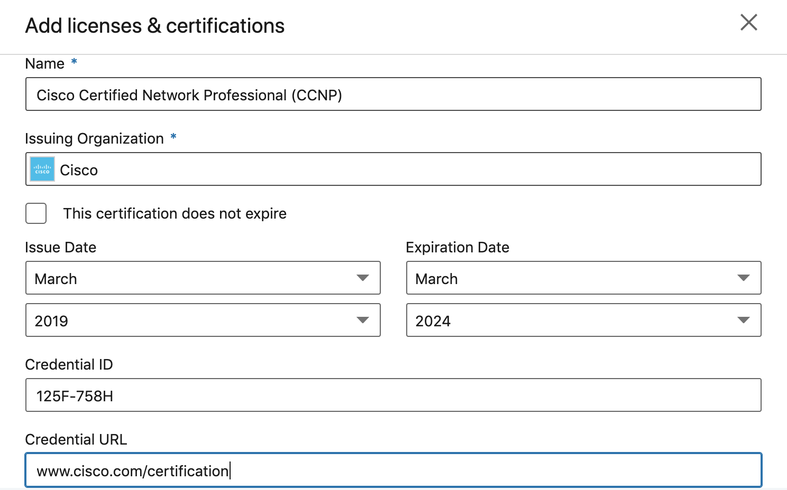
STEP 02
Add Your Education, Licenses & Certifications
Members with education, license, or certification information receive up to 11x more Profile views and 6x more connection requests.
Be more easily identified by recruiters looking for specific training or credentials.
Leverage alumni networks.
Notes:
​ YOU CAN SAY​
Adding your industry is really important. Often it’s how others will find you and add you to their professional network.​
In addition, adding your industry will give you up to 9X more profile views!​
Members with industry information are discovered up to 38X more in recruiter searches​
It’s simple, click the pencil at the top of your profile where your headshot and name are and scroll down to edit or add your industry.​

Slide 22
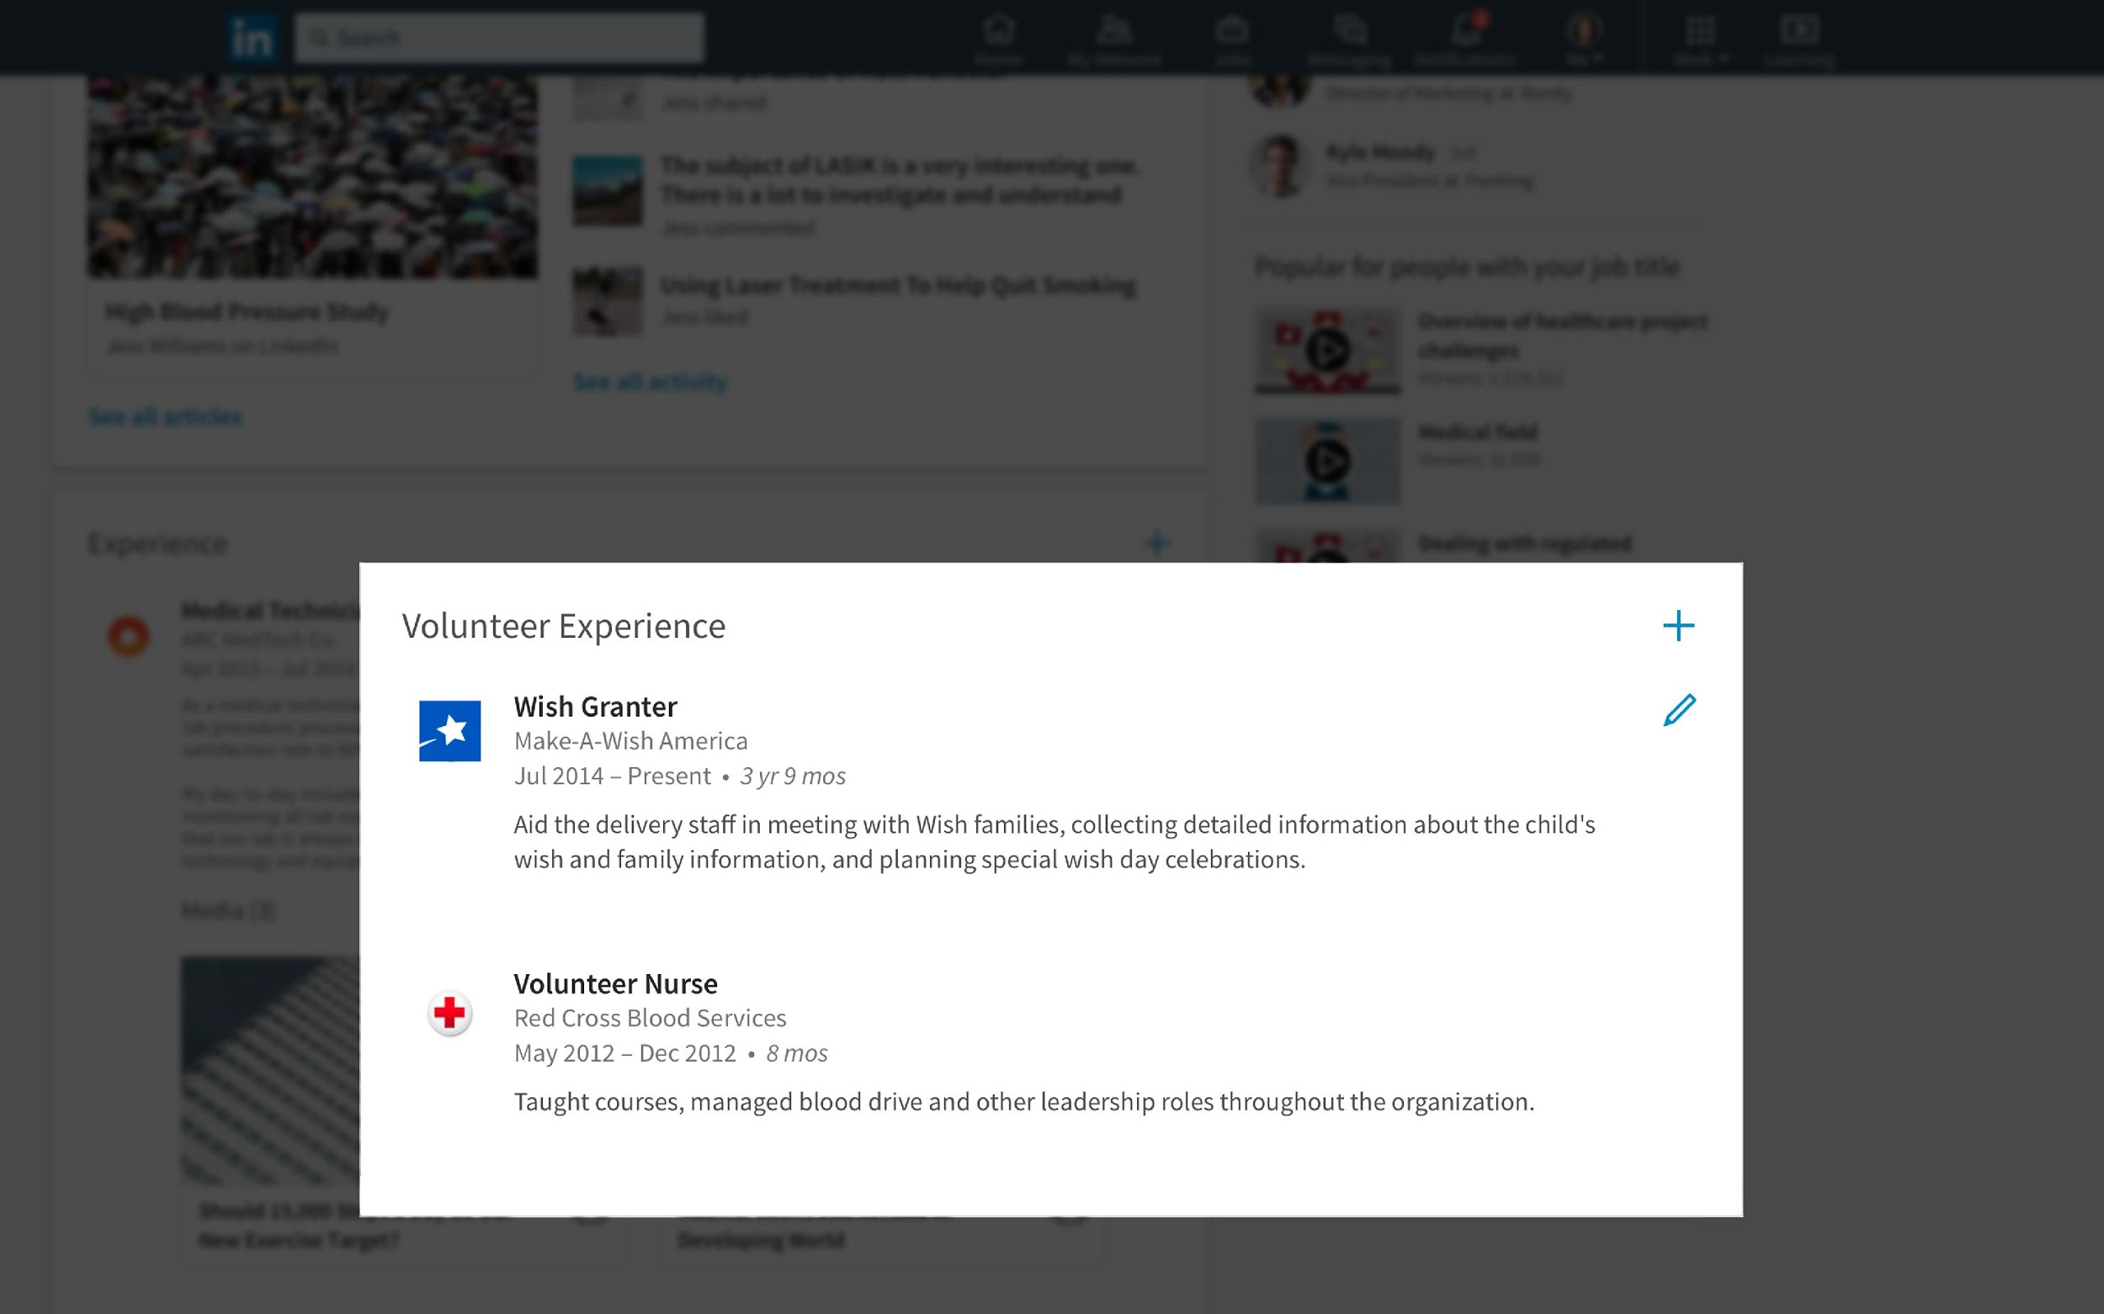
STEP 02
Include Your Volunteer Experience
Members who add volunteer experience and causes get up to 6x more Profile views than those without
Volunteer experience can help:
Fill an employment gap
Demonstrate commitment
Build new skills
Lead to a new recommendation
Notes:
​ YOU CAN SAY​
Adding your industry is really important. Often it’s how others will find you and add you to their professional network.​
In addition, adding your industry will give you up to 9X more profile views!​
Members with industry information are discovered up to 38X more in recruiter searches​
It’s simple, click the pencil at the top of your profile where your headshot and name are and scroll down to edit or add your industry.​

Slide 23
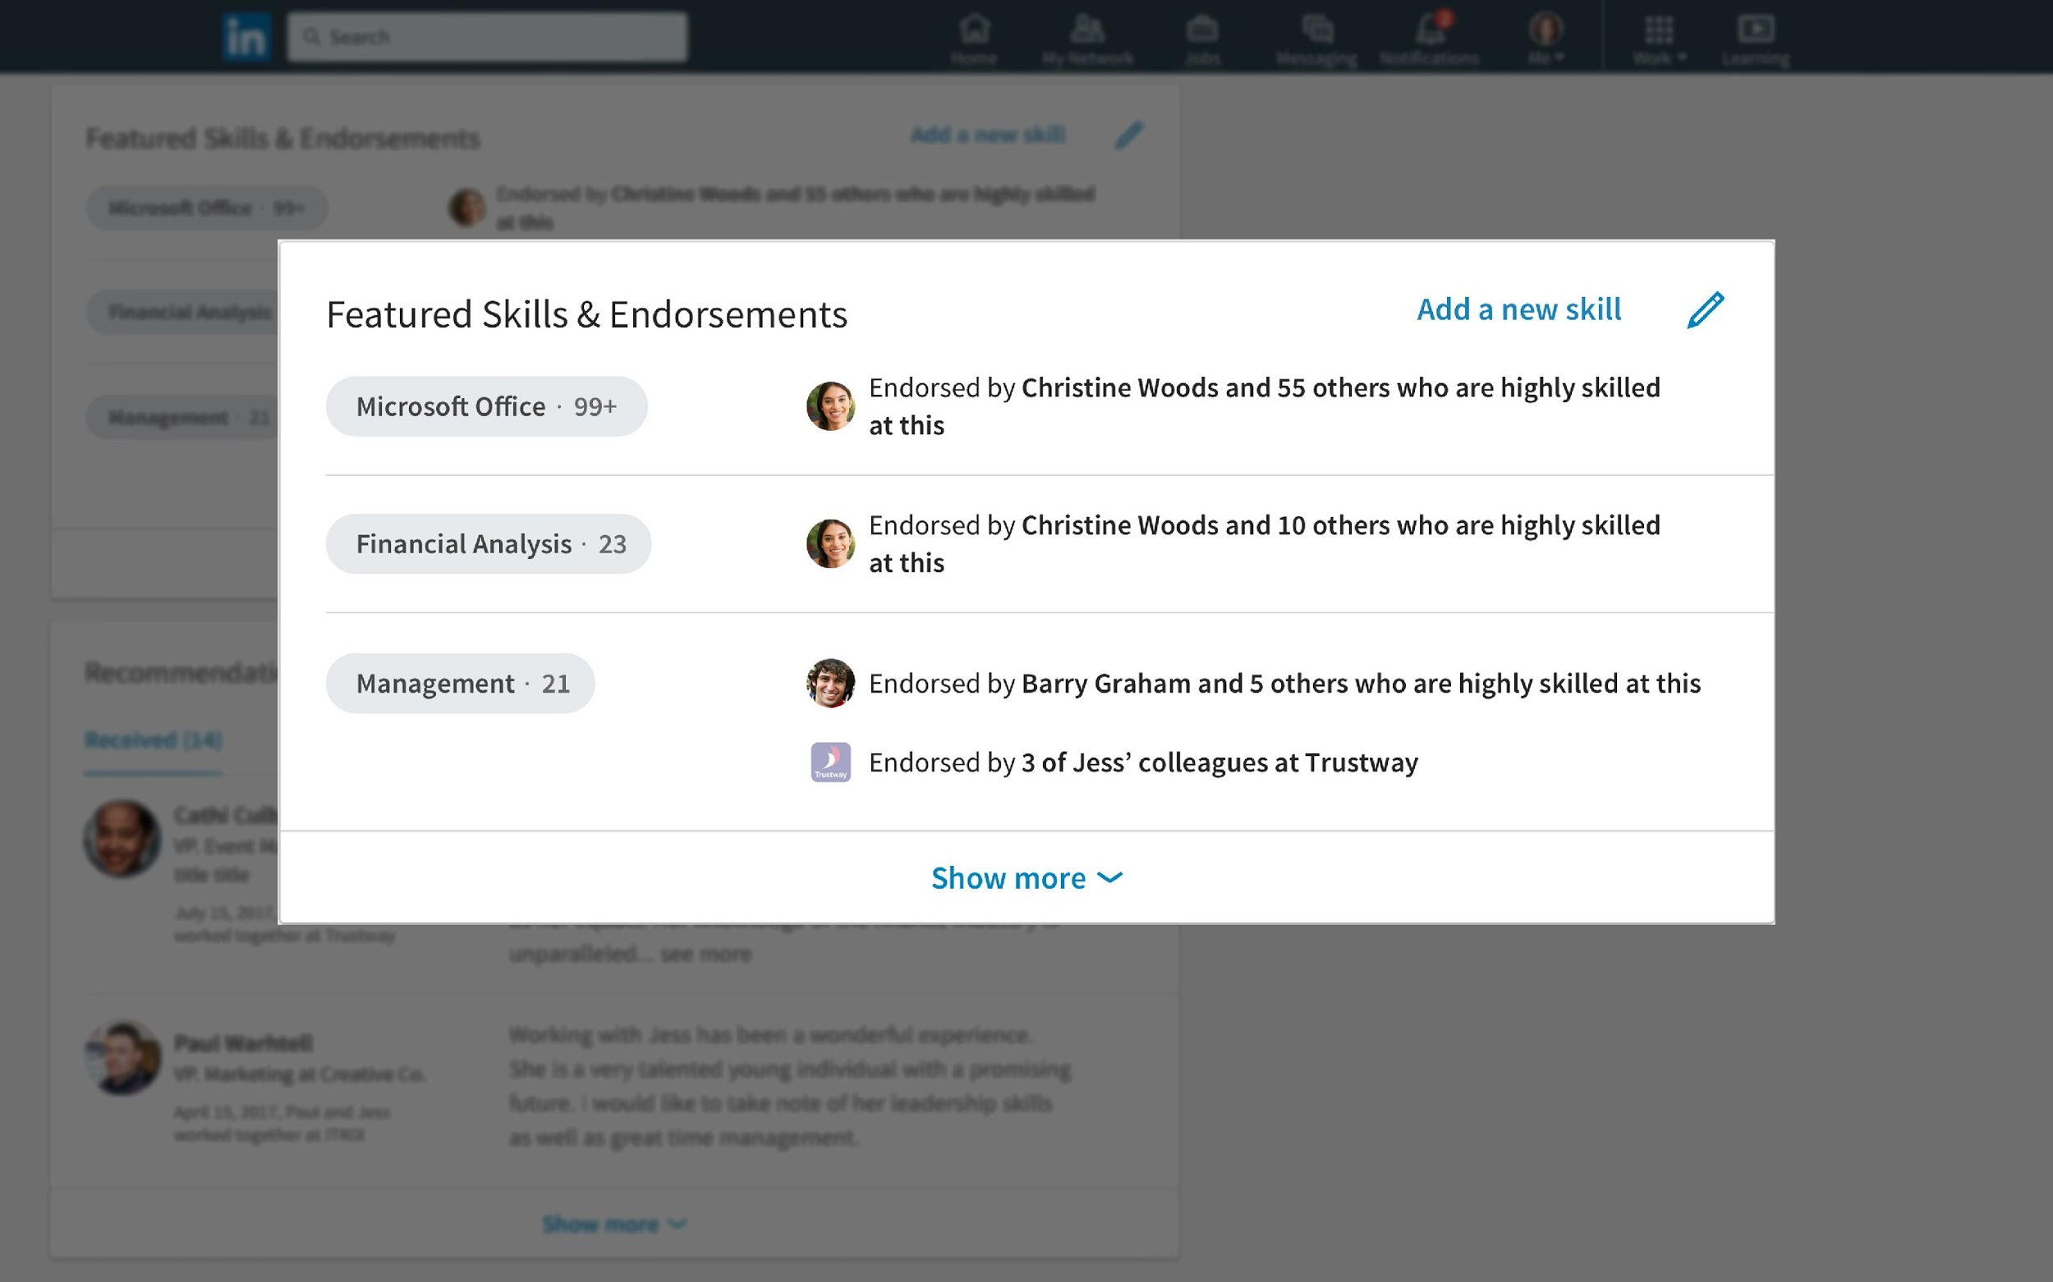
STEP 02
Showcase Your Skills
Members who add 5 or more skills receive up to 17x more Profile views and 27x more likely to be found by recruiters.
Endorsements validate you possess the skills not your level of expertise.
Choose the skills to highlight based on the skills most important to the type of jobs you want.
Notes:
​ YOU CAN SAY​
Adding your industry is really important. Often it’s how others will find you and add you to their professional network.​
In addition, adding your industry will give you up to 9X more profile views!​
Members with industry information are discovered up to 38X more in recruiter searches​
It’s simple, click the pencil at the top of your profile where your headshot and name are and scroll down to edit or add your industry.​

Slide 24
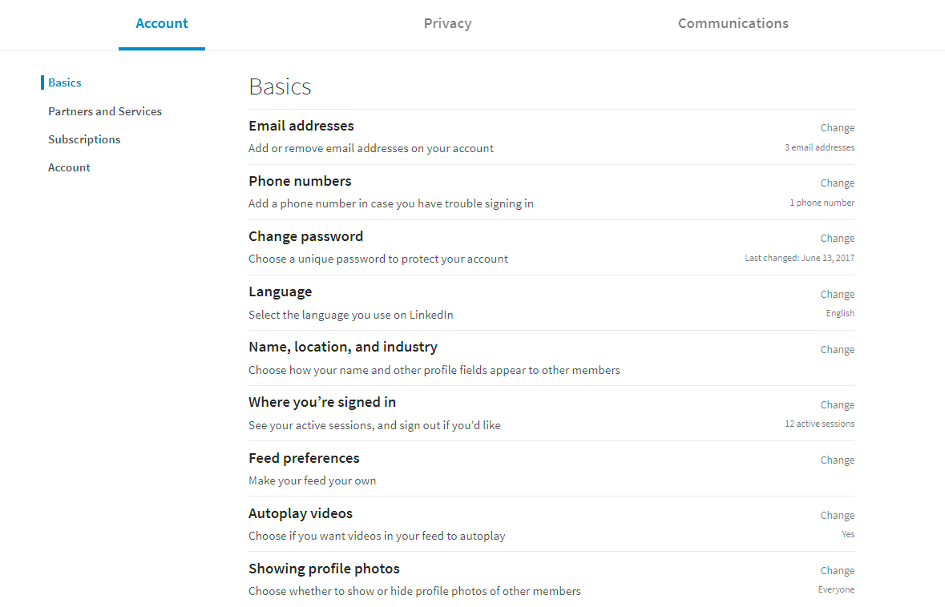
STEP 02
Privacy Settings
Click the “Me” icon at the top of your LinkedIn homepage.
In the dropdown menu, select “Settings & Privacy” to begin managing your account settings.
For example, you can:
Add an additional email address
Change your password
Control your notification preferences
Notes:
GOAL: Show jobseekers where they can control their settings and privacy.​
​ SAY: Visit your privacy settings to control your notifications, recover your account, change your password, and more.​

Slide 25
Time for a break!
See you in 5 minutes
Notes:
DO: Invite participants to take a 5 minute break. ​

Slide 26
STEP 03
Discover Existing Connections
Build Your LinkedIn Network to Connect to Job Opportunities
Search for New Connections
Message Connections
Add Value
DID YOU KNOW? 70% of people were hired at a company where they had a connection.
Notes:
SAY: 70% of people were hired at a company where they had a connection. Let’s find those connections for you.​

Slide 27
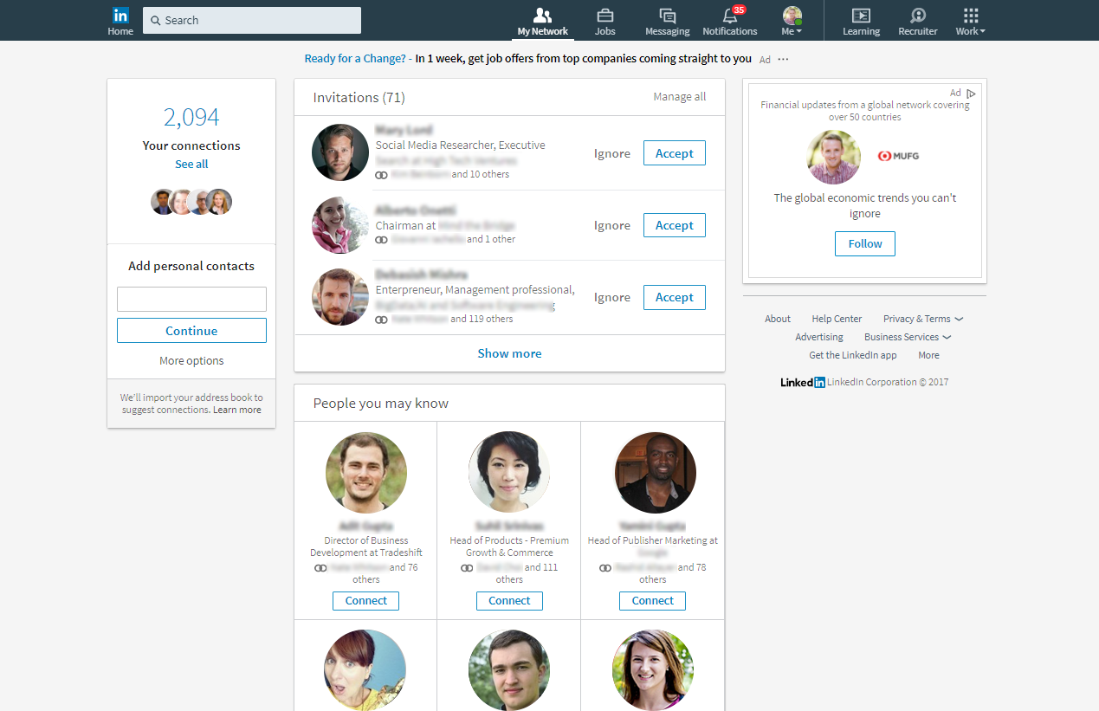
STEP 03
Discover Existing Connections
Click “My Network” in the top navigation to find people you already know.
The recommendations in this section improve as you add connections. Check back frequently as your network grows.
Notes:
SAY: Use the My Network page of your LinkedIn account to find People You May Know based on your LinkedIn profile. ​
​ DO: Click on the screenshot on the left of the slide to play the video.​

Slide 28
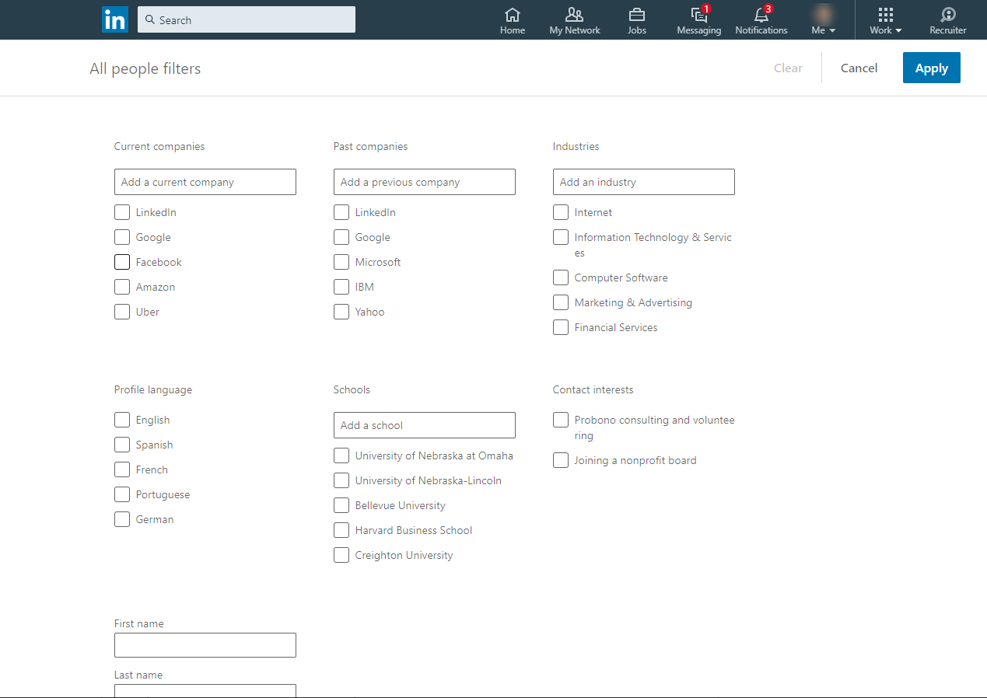
STEP 03
Search for New Connections
Use the search bar in the top navigation to find new connections by:
Name
Company
School
Notes:
SAY: Use the top search bar to find new connections based on their name, school, company, and more.​
​ ​

Slide 29
STEP 03
Message Connections
Messaging LinkedIn Contact
Send messages to your connections directly from:
The LinkedIn messaging page
Your connections page
Their profile page
Notes:
SAY: Strengthen your relationships by sending personalized messages to your connections.​
​ DO: Click middle of the screenshot to play the video.

Slide 30
STEP 03
Add Value
Like and share things that people in your network will care about and post
Give testimonials and recommendations to others
Invest time in your connections, take them to lunch or even just listen
Share your expertise and write helpful articles
Make introductions for others
Notes:
SAY: Your network will work best when you help out your connections. You can do this by liking and sharing their posts, giving endorsements, sharing your expertise, and more.​
​ ​

Slide 31
STEP 04
Get the LinkedIn Job Search App
Search and Apply for Jobs on LinkedIn
Set Career Interests
Search for Jobs
Review “Jobs You May Be Interested In”
Use Your Network
Follow Companies
DID YOU KNOW? There are over 10 million employers and 7.5 million monthly job postings on LinkedIn.
Apply Actively
Notes:
SAY: Find where you want to work. And discover who works there before you apply for a job.​
​ ​

Slide 32
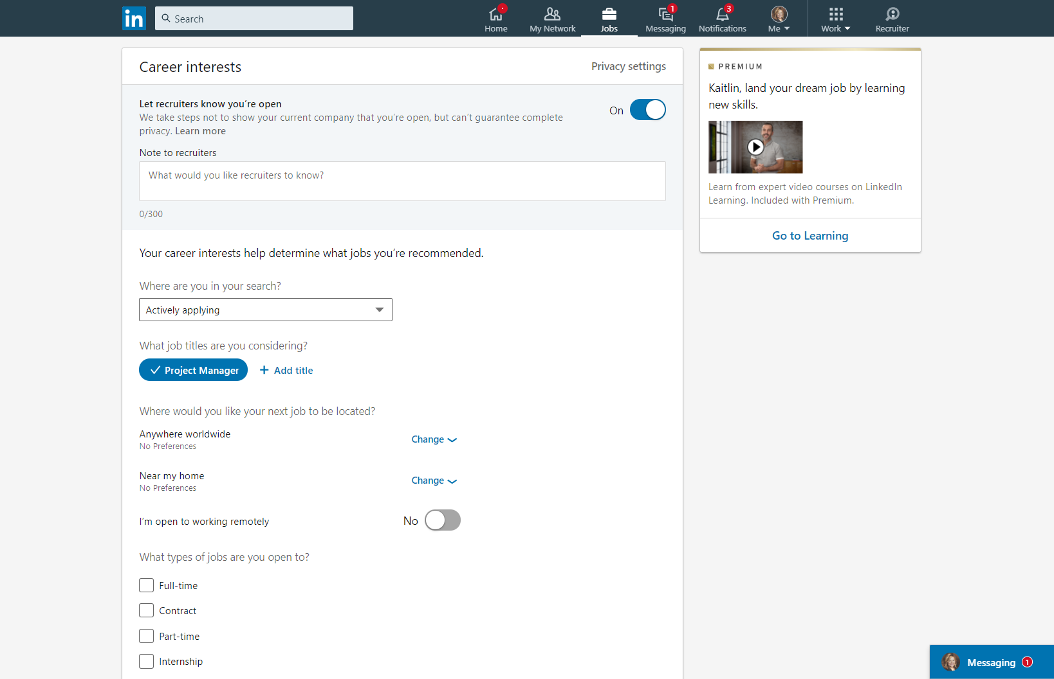
STEP 04
Set Career Interests
Include potential job titles and locations in your career interests to receive more relevant job suggestions
Turn on the Open Candidates setting to let employers know you are actively searching and available for a new job.
Download the LinkedIn Job Search Mobile App to see new job notifications quickly
Notes:
GOAL: Have jobseekers update their career interests, or know how to update their career interests, so recruiters and employers are more likely to find them. ​
​ SAY: Let employers and recruiters know you are actively looking for a job by setting yourself as an open candidate and updating your career interests. ​
​ The LinkedIn Job Search Mobile App also has additional tools to help you stay on top of your job search. For example, get notified when your application has been viewed, a saved job is about to expire, or when there are new jobs that meet your search criteria.​
​ ​

Slide 33
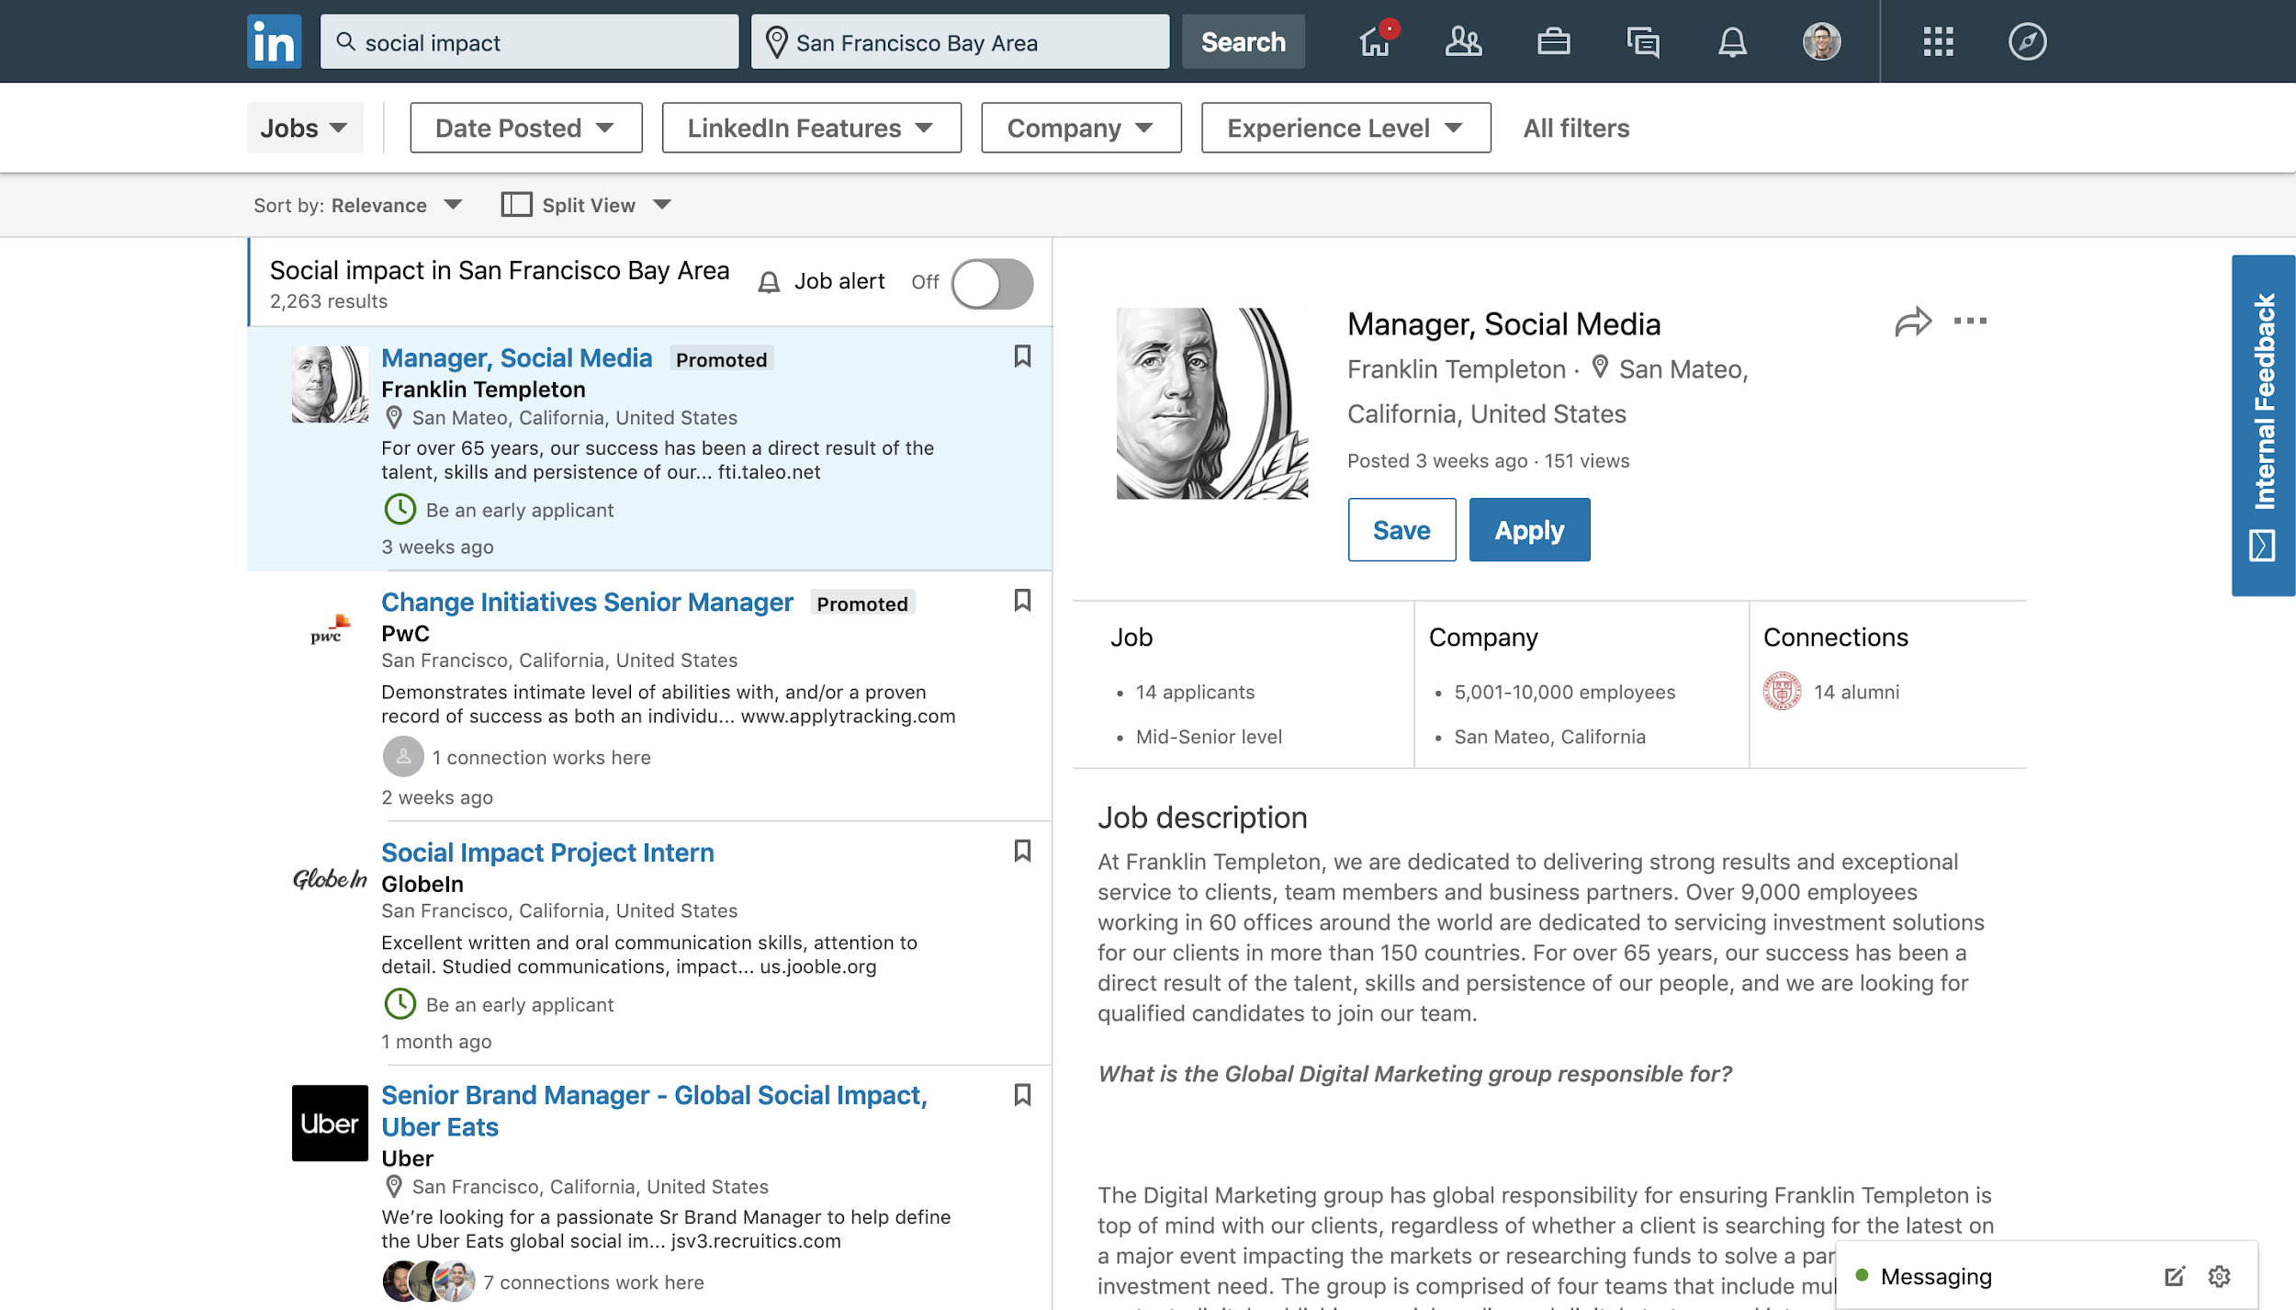
STEP 04
Search for Jobs
Use LinkedIn’s search filters to find jobs by:
Keyword
Job title
Company
Location
Function
Industry
Experience level
Date posted
Notes:
GOAL: For jobseekers to become comfortable with searching for jobs and saving them for later.​
​ SAY: Search by keyword, job title, company, location, function, industry, experience level, and date posted using LinkedIn’s search filters.​

Slide 34
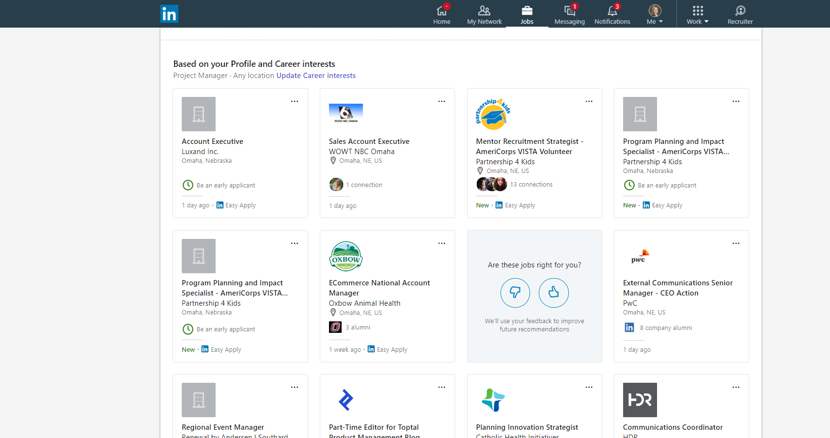
STEP 04
Review Jobs You May Be Interested In
For the best jobs, make sure your profile is filled out with accurate:
Work experience
Skills
Location information
Notes:
SAY: Review your daily Jobs You May Be Interested In by clicking on the “Jobs” icon in the top navigation, based on your job preferences, profile, companies you follow, network, interests, and other activities on LinkedIn.​
The more you use LinkedIn, the more accurate job recommendations you will receive.​
​ ​

Slide 35
STEP 04
Use Your Network
Ask for a job referral by reaching out to your connections at a company you would like to apply to.
Notes:
SAY: Referrals are a great way to get your foot in the door. If you have a connection at a company you would like to work for, ask them for an introduction or a referral.​

Slide 36
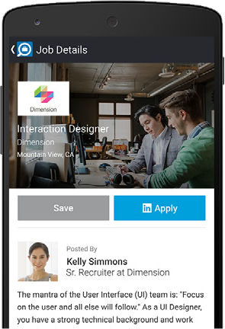
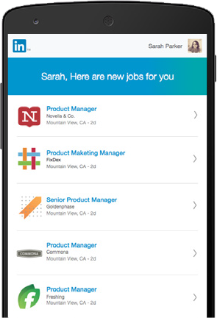
STEP 04
Apply Actively
Use the “Easy Apply” or “Apply on company website” button to quickly apply for a job you want.
Stay on top of your job search by using the LinkedIn Mobile App to find and apply for new jobs from anywhere at any time.
Applicants who apply to jobs within the first three days of posting are 13% more likely to get the job.
Notes:
SAY: On each job posting, you’ll see either the “Easy Apply” or “Apply on company website” button to apply for the job. ​
To apply for jobs on the go, use the LinkedIn Mobile App.​
​ ​

Slide 37
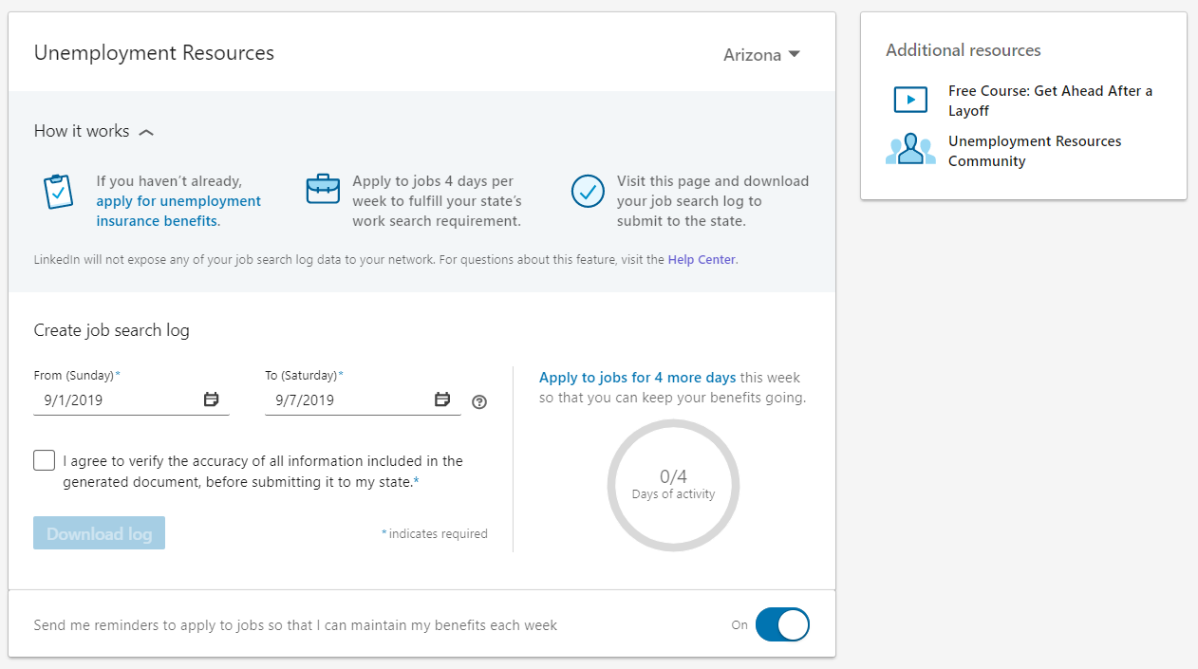
STEP 05
Save time by automatically completing your job search log form.
Use LinkedIn to download an auto-filled form.
1
Open your web browser and go to
linkedin.com/unemployment.
2
Sign in with an existing LinkedIn account, or click “Join now” to create one.
Follow the instructions, then click “Download log” to generate a PDF
of your work search log.
3
4
Keep the log for your own records, or submit it online based on your state’s requirements.
linkedin.com/unemployment

Slide 38
EC
LinkedIn Help Center
Extra Credit
LinkedIn Official Blog
LinkedIn Learning
LinkedIn ProFinder
Additional Resources to Help You Land Your Next Job
LinkedIn Premium Business or Career
Notes:
GOAL: Show jobseekers that LinkedIn has many resources to help them advance their careers.​
​ SAY: LinkedIn has several resources to help you grow professionally. ​
These resources will help you use LinkedIn, stay informed on the latest job search news, apply to gigs, and learn new professional skills, get salary information for jobs you’re interested in, and more.​
​ Good luck on your job search!​
​ ​

Slide 39
for Jobseekers
How to Connect to Jobs on LinkedIn
Notes:
GOAL: Welcome and greet participants.​
​
DO: Greet jobseekers and introduce yourself. ​
Start the jobseeker workshop and move on to the next slide.​
​

